Slide 1
Stockholm Water Technology
Bringing Sustainability to Water treatment
Karthik Laxman Kunjali – CEO
Email: Karthik@stockholmwater.com
Cleantech Scandinavia, Malmo - 2021

Slide 2


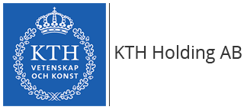




SWT history & development
Jan 2018
Jan 2021
Jan 2022
Jan 2023
R&D
First Sales
SEED Round
2006
Jan 2019
June 2021
June 2022
SWT Incorporated Jan 2018
Targeted applications
Valuable market traction
Core team in place
Increase sales revenue
Targeted commercial products
Market expansion
New applications
Development & traction
Sales & Market presence
Expansion
SWT Partners / Investors
All rights reserved – Copyright ©️ SWT 2021- Strictly confidential

Slide 3
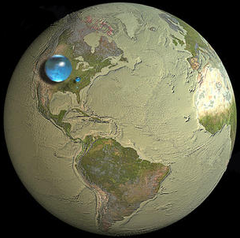
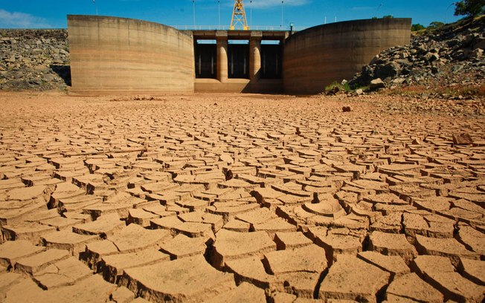
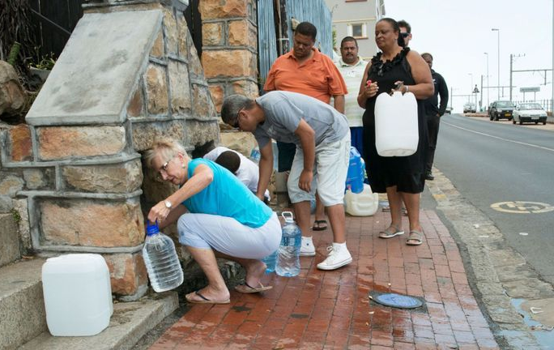
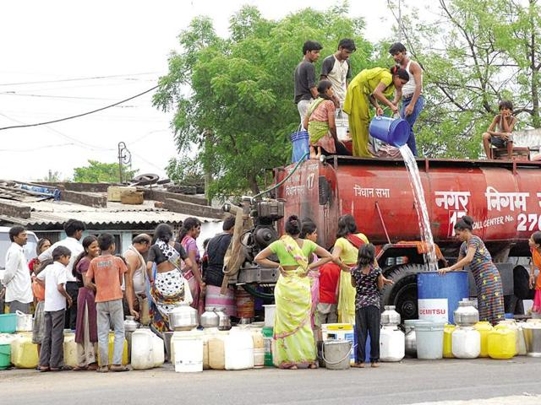
SWT Mission: Clean water & sustainability
All Fresh Water on Earth
Sao Paulo almost runs out of water - 2014
Cape Town almost runs out of water – 2017
Chennai, India almost runs out of water - 2019
THOUSANDS HAVE LIVED WITHOUT LOVE
NOT ONE WITHOUT WATER
W.H. Auden
All rights reserved – Copyright ©️ SWT 2021- Strictly confidential

Slide 4

SWT Mission: Clean water & sustainability
Recharge
Reduce
Circular water economy
Clean
Reuse
Energy-Water Nexus
Low Energy Footprint Water treatment
Store Energy & Clean Water Simultaneously
United Nations Sustainability Development Goal 6
United Nations Sustainability Development Goal 7
All rights reserved – Copyright ©️ SWT 2021- Strictly confidential

Slide 5
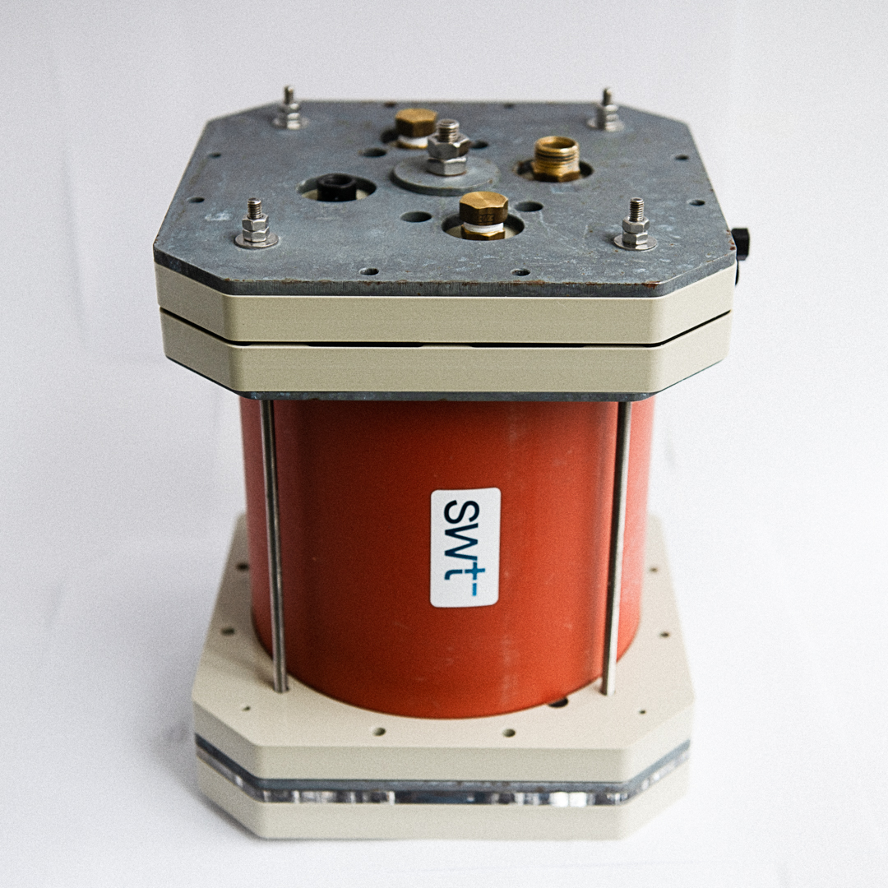
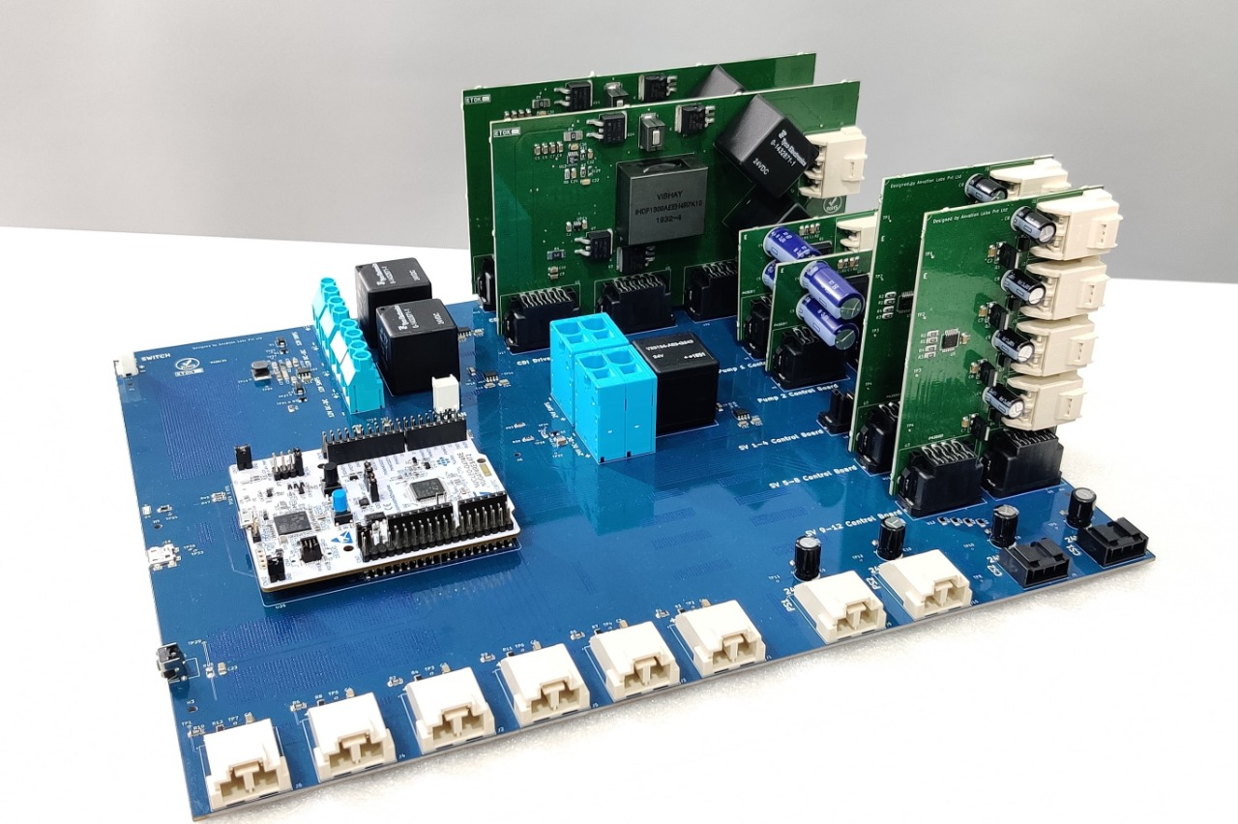
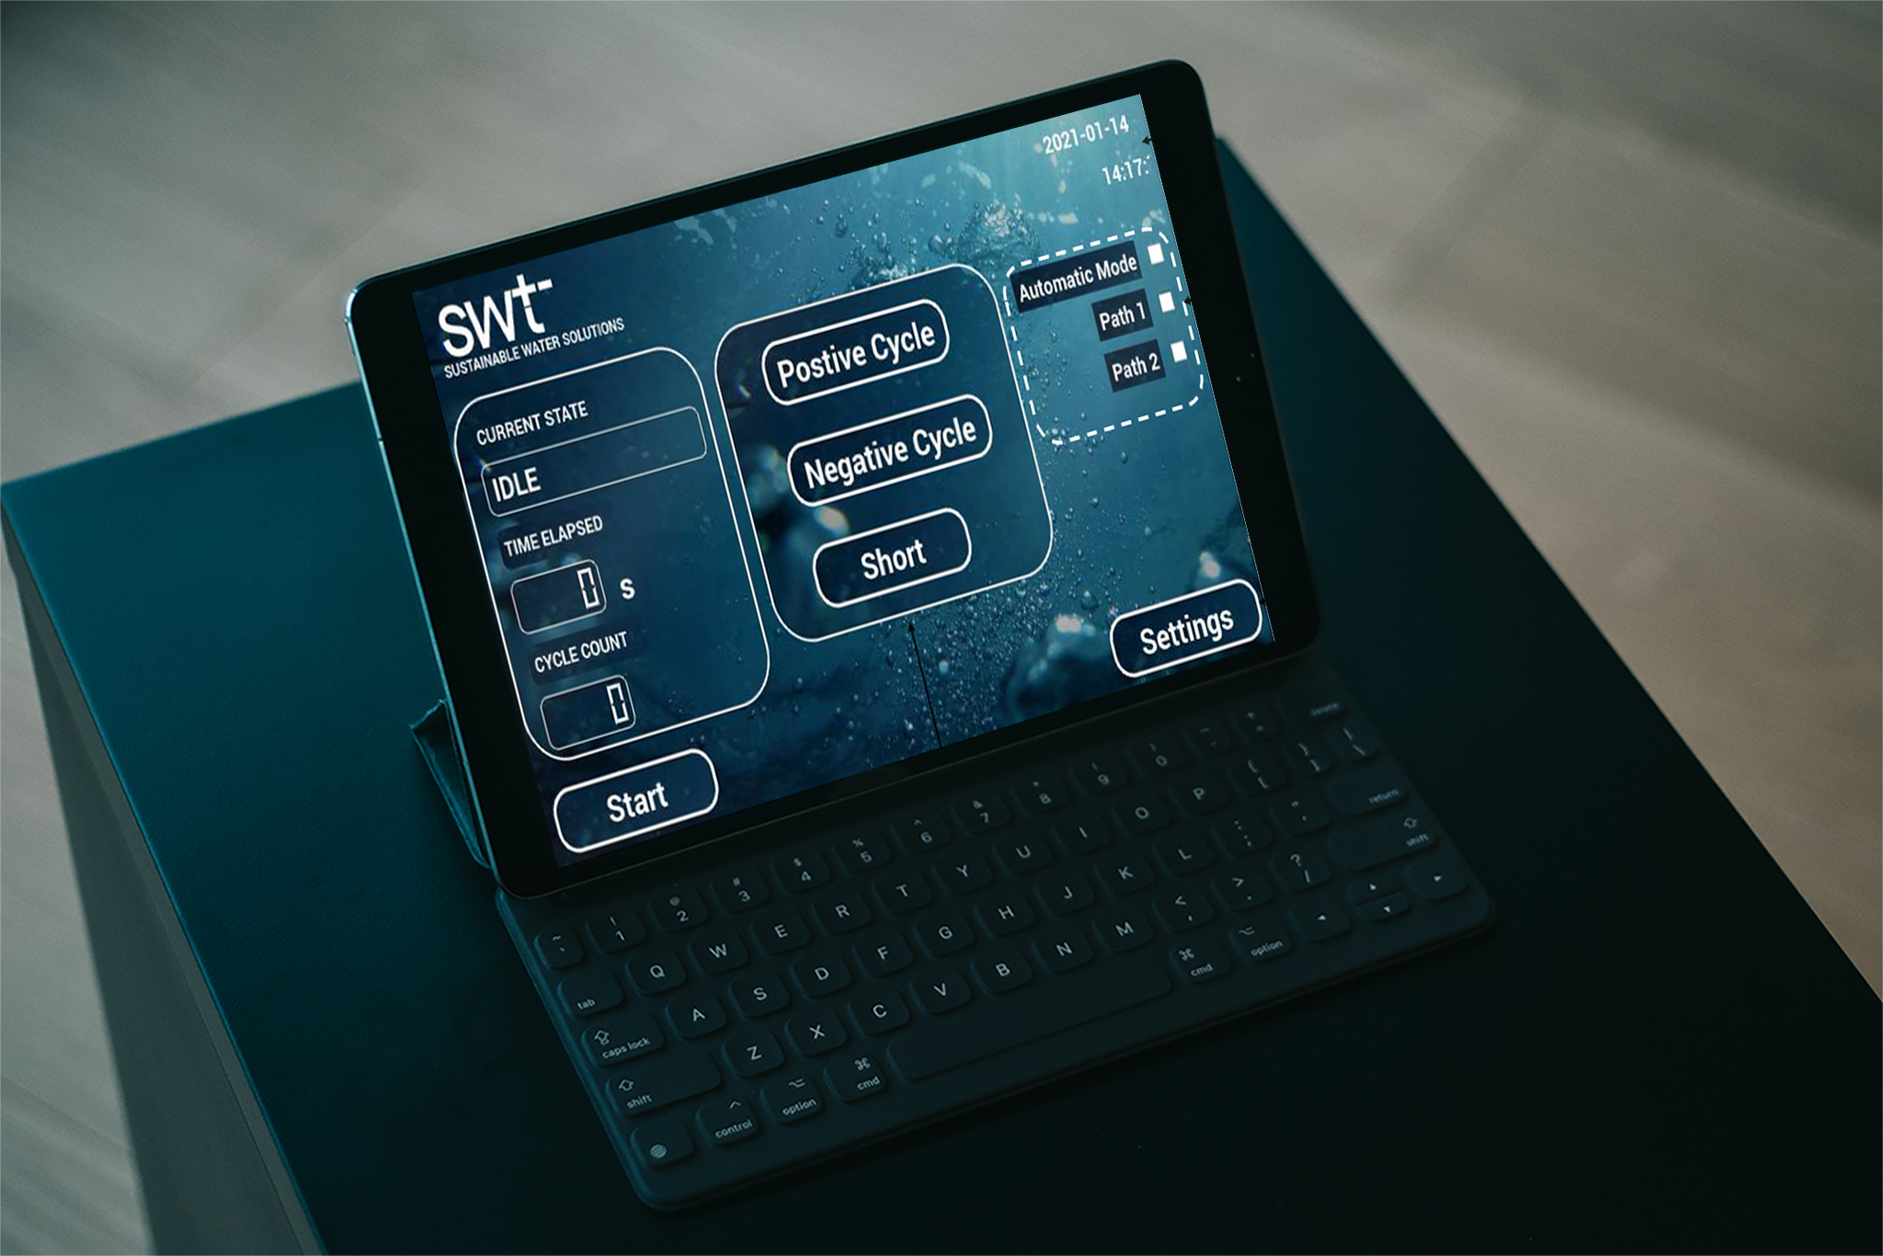
SWT core building blocks
STORES ENERGY WHILE CLEANING WATER – MORE THAN JUST HARDWARE
Patented Hardware
Embedded Controls
Data-mining Software
+
+
Energy - 0.3 – 1 kWh/m³
Stores energy during operation
Membrane independent
Chemical free
Water temperature (4 – 85 deg)
Tailored output water quality
High water recovery (> 85%)
Wide contaminant removal profile
Data storage and IoT enabled
Graphical system history
User controlled output water
Smart technology for smart cities of the future
INDUSTRY
MUNICIPAL
CONSUMER
Applicable Market Segments:
All rights reserved – Copyright ©️ SWT 2021- Strictly confidential

Slide 6
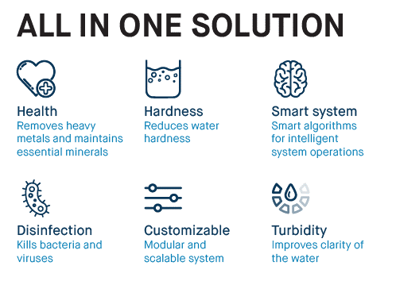
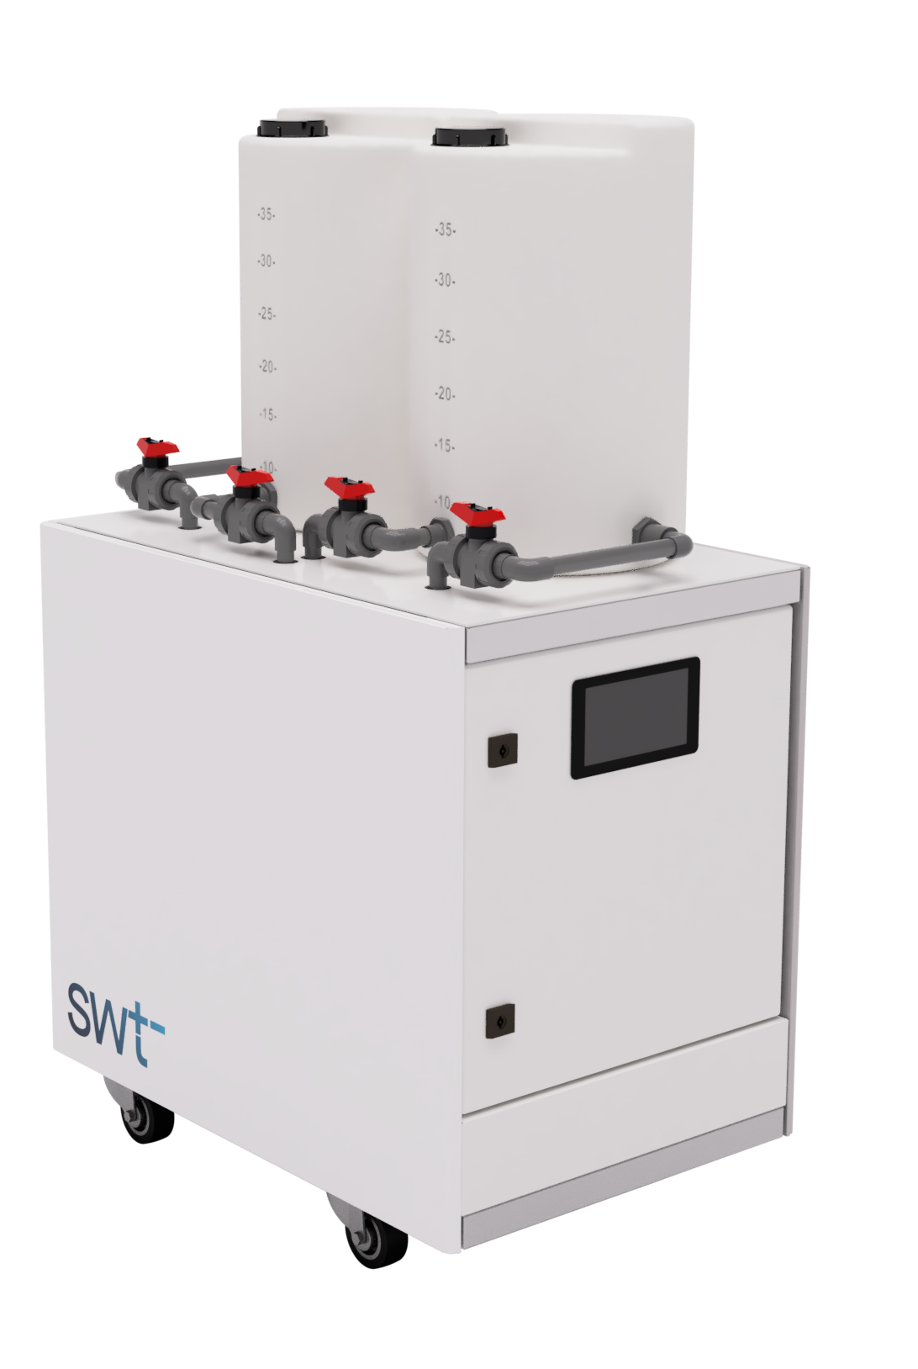
SWT products – FORS family
COMPRISES OF SWT CORE COMPONENTS PACKAGED INTO PRODUCTS
FORS
Ground/well and municipal water treatment
Drinking Water to Ultraclean Water
Highly scalable
Saves water + Saves energy
High Water Recovery (< 15% wastage)
40% Lower Energy Consumption (0.8 kWh/m³)
Plug & play system
Chemical free operation
Smart LCD touch screen interface
Remote system access & control
Adjustable output water quality
On-board memory for data storage
All rights reserved – Copyright ©️ SWT 2021- Strictly confidential

Slide 7
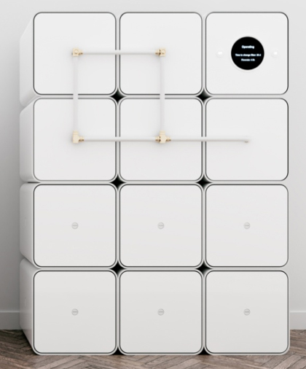
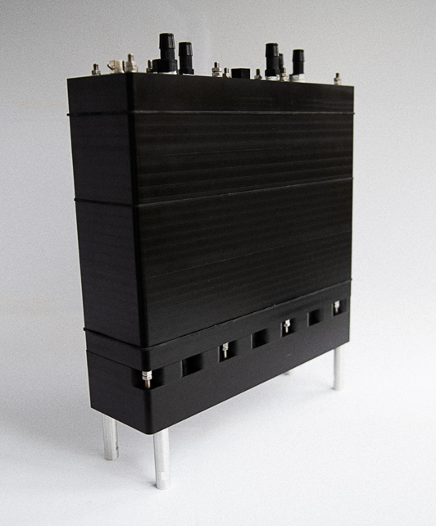
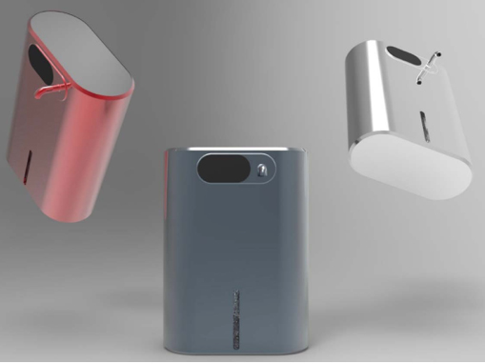
SWT products (coming soon)
COMPRISES OF SWT CORE COMPONENTS PACKAGED INTO PRODUCTS
STRÖM
JOKK - U
BJOKK - T
Under the sink unit
Market introduction (Q2 2022)
Drinking water output
Tap water input
Table top or wall mounted unit
Market introduction (Q1 2023)
Drinking water – up to 50 litres per day
Tap water input
Consistent output water quality – irrespective of input water quality changes
Programmable output water quality
Modular & highly scalable solution
Market introduction (Q4 2022)
All rights reserved – Copyright ©️ SWT 2021- Strictly confidential

Slide 8
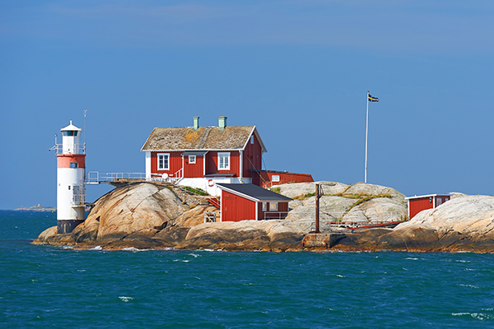
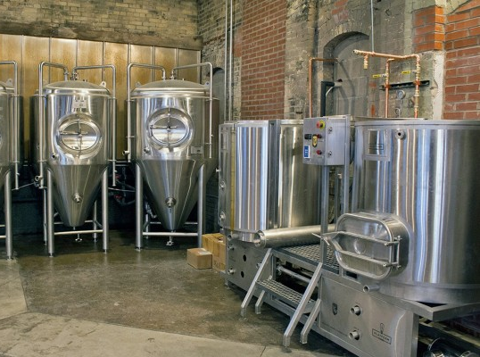
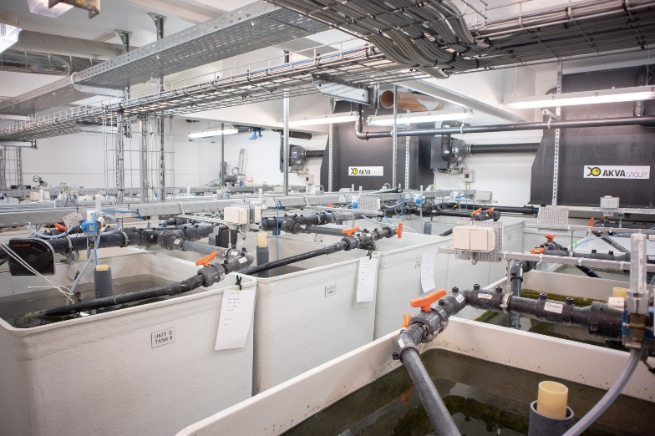
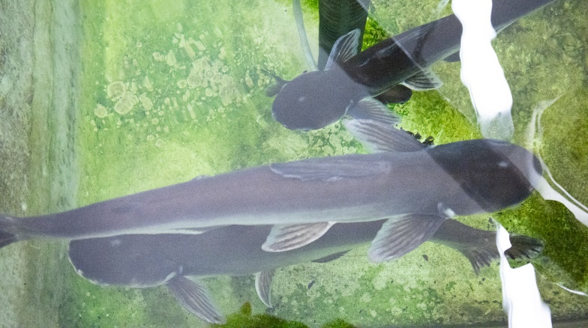
Market & applications
Current Customers
Total Addressable Market
415 Bn €
Serviceable Addressable Market
100 Bn €
Serviceable Obtainable Market (Global)
60 Bn €
Serviceable Obtainable Market (EU)
12 Bn €
Off-grid Homes
Breweries
Aquaculture Farms

Slide 9
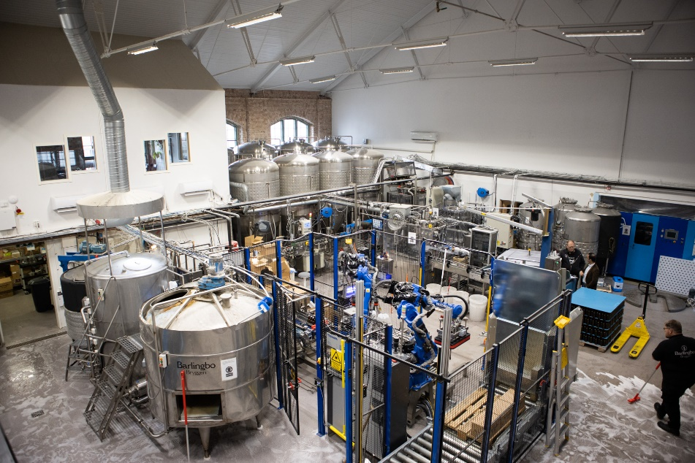
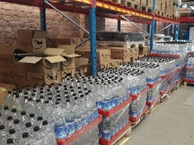
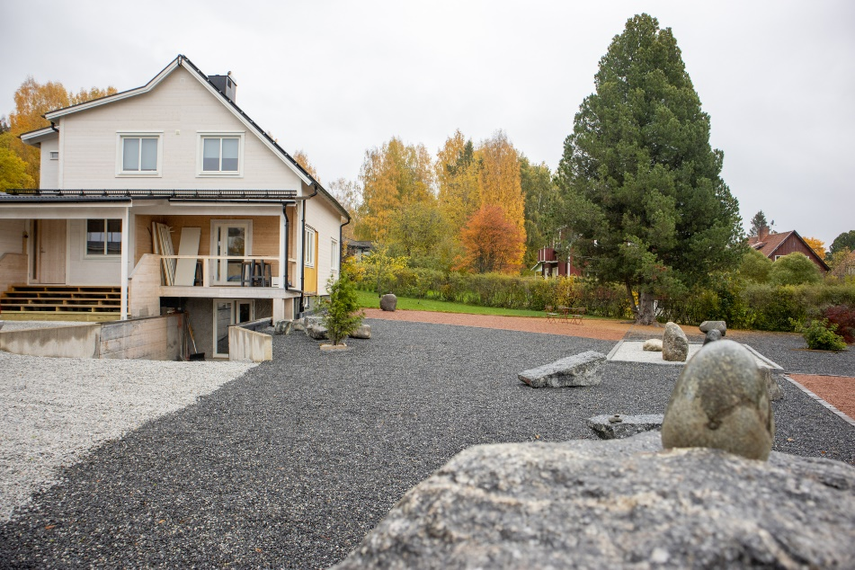
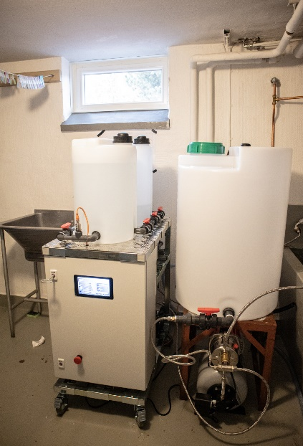
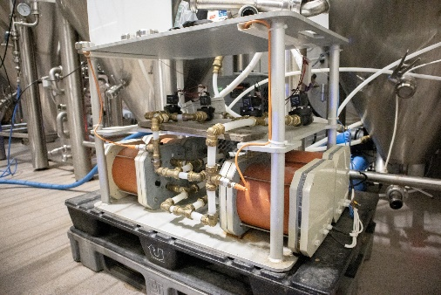
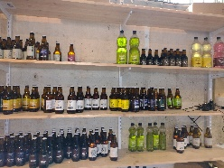
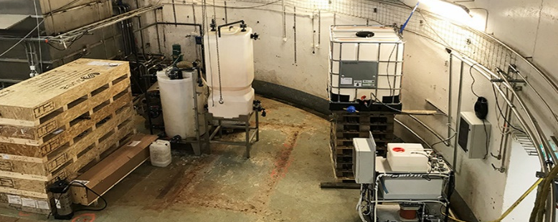
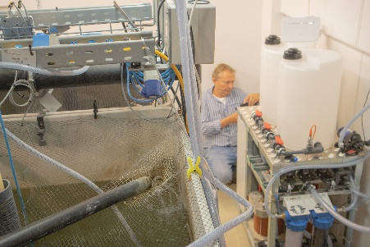
SWT commercial installations
Microbrewery – Sweden
Hard Municipal Water – Sweden
Aquaculture Farm – Denmark
Municipal wastewater treatment plant – Sweden

Slide 10
Revenue model (B2B Only)
Direct and channel sales of core products with potential to provide hardware rental and licensing
Current revenue model
Future potential revenue models
Direct/Indirect Sales
Indirect
Licencing
Solutions
System integrators
High volume consumer products
Consumer homes, Beweries
SWT majority of water solution
Small & medium scale installations
Large scale projects
SWT part of water treatment solution
PoU systems (home drinking water)
Other large volume products
Primary model adopted
All rights reserved – Copyright ©️ SWT 2021- Strictly confidential

Slide 11

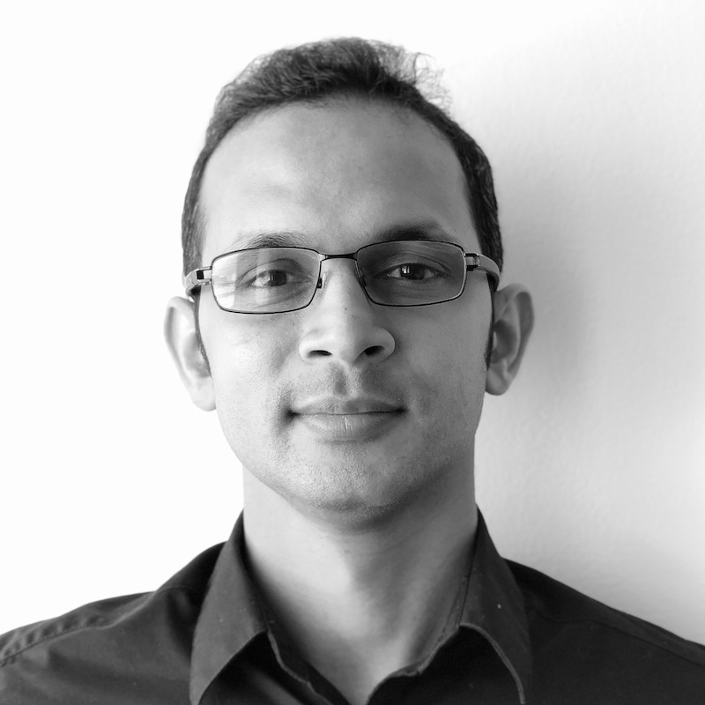
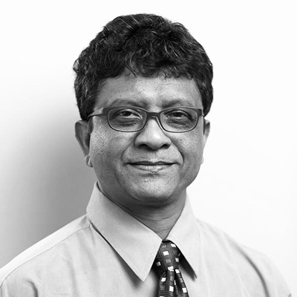
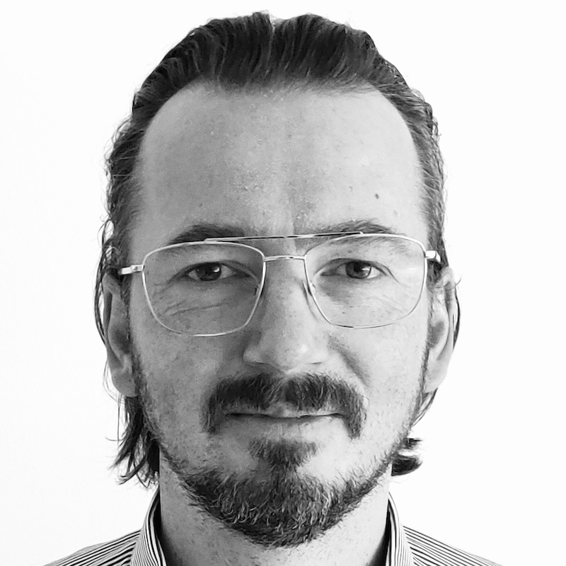
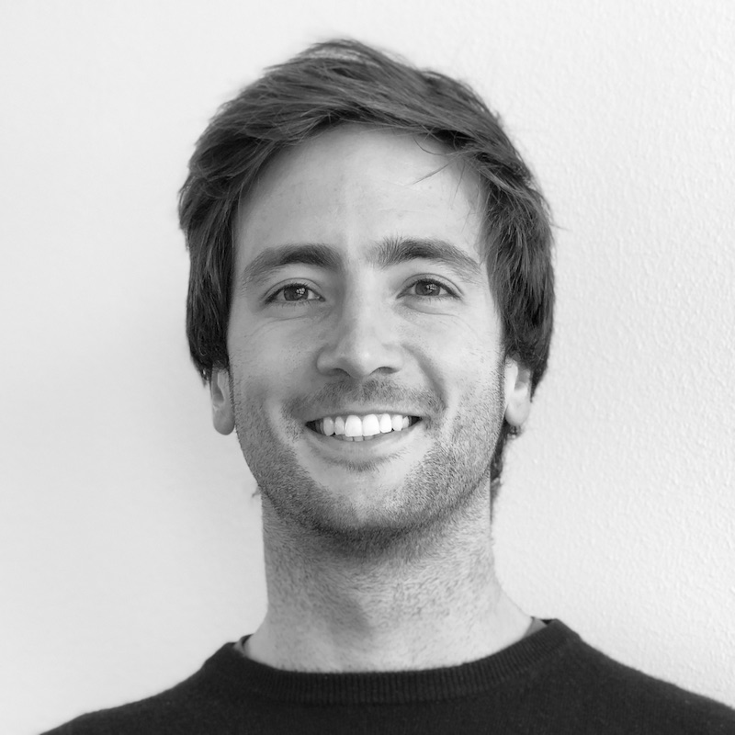
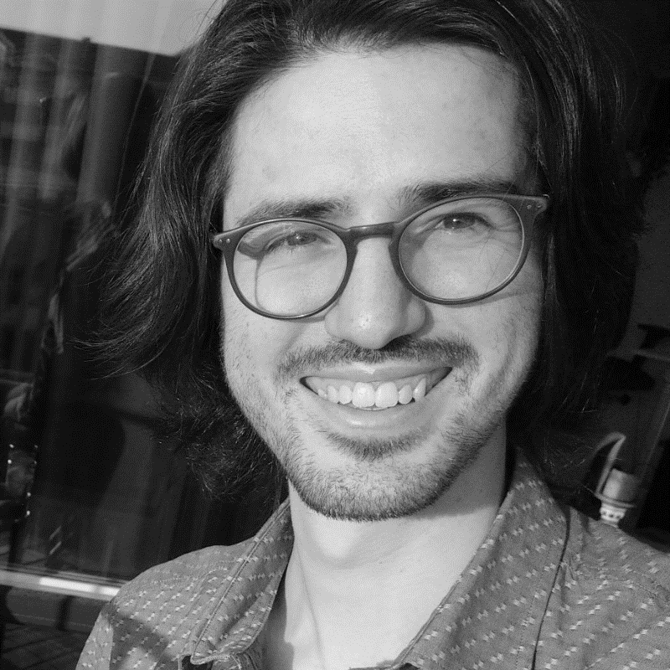
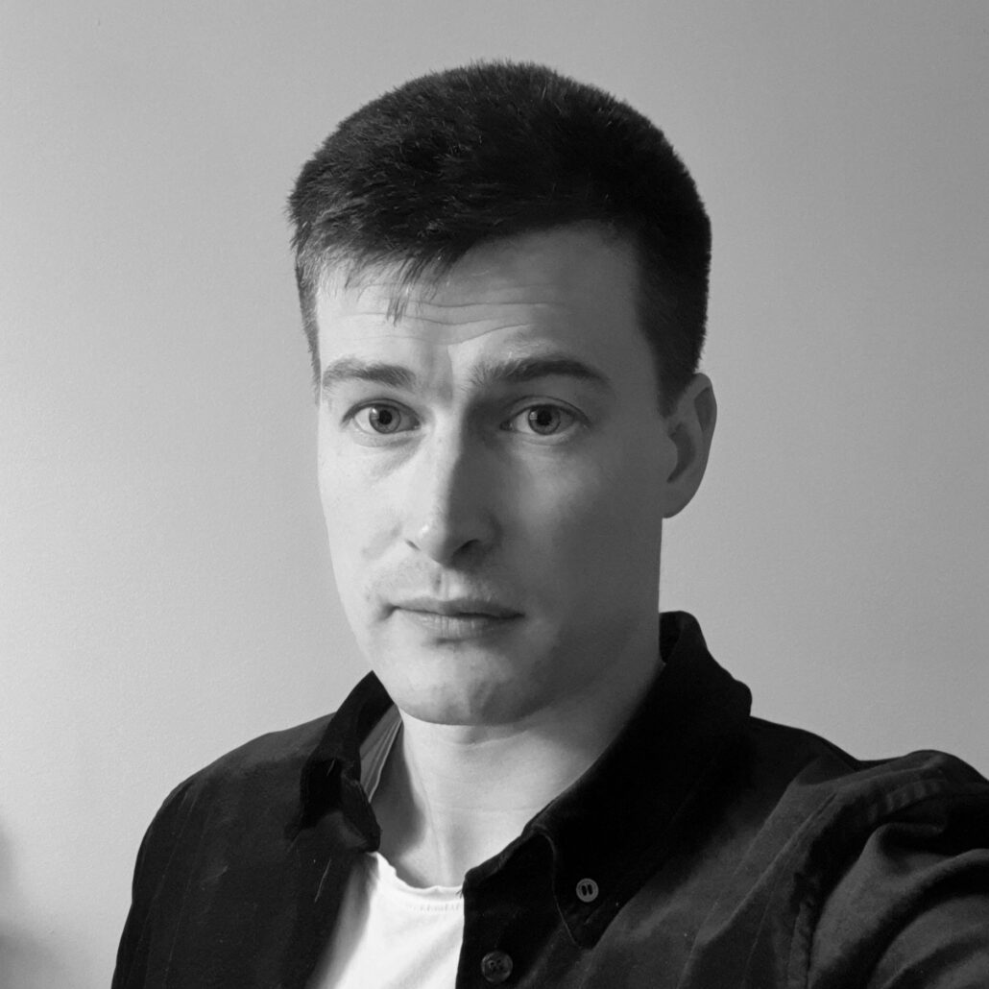
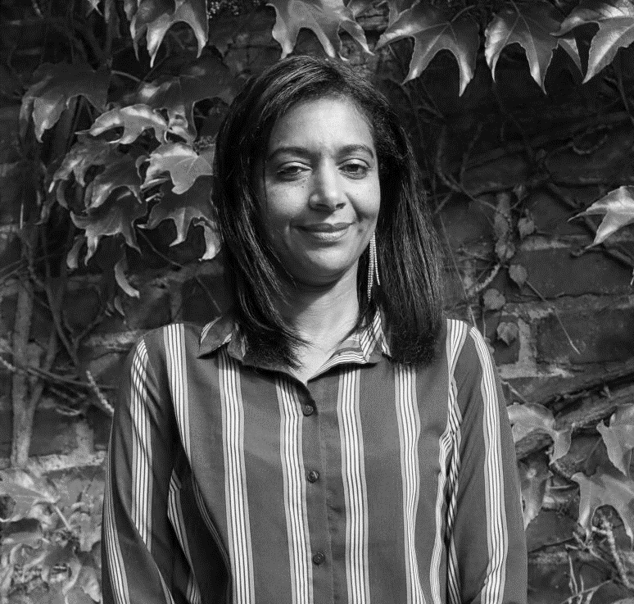
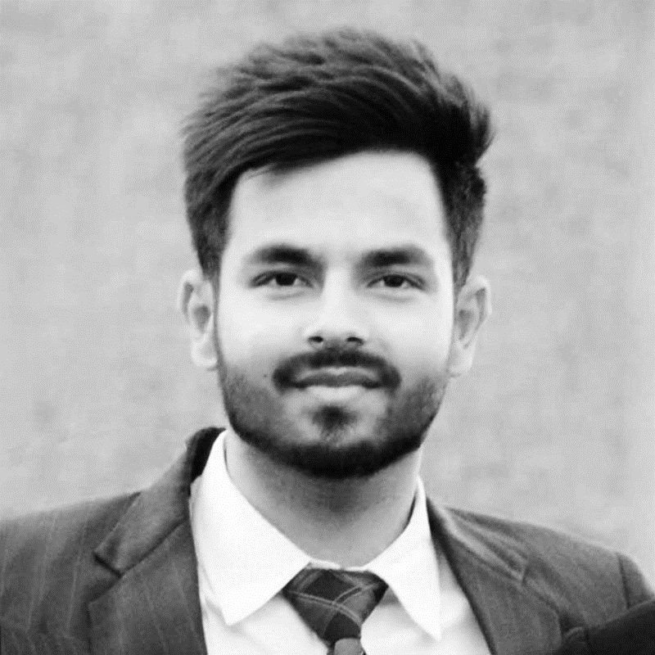
SWT Team
Dr. Karthik Laxman
Prof. Joydeep Dutta
Roger Forsberg
Alessandro Armani
Co-Founder & CEO
Co-Founder & CSA
Chief Commercial Officer
Lab Engg & Biz. Dev
Mattia Dalla Via
Simon Alin
Nilza Martins Motty
Ankit Bhardwaj
Embedded Engineer
Product Design Engineer
Manufacturing Associate
Manufacturing Intern

Slide 12
Bringing circularity & sustainability
to Europe’s water resources
Opening for Investments
Contact:
Email: info@stockholmwater.com
Mobile: +46 (0) 72 8585 399
Website: www.stockholmwater.com
stockholmwater.com

