Slide 1
Criticality by 2029 – we are building Sweden’s next nuclear reactor

Slide 2
Why? We are facing a climate crisis…
Global C02 emissions from fossil fuels and industry (gigatonne)
37.1
34.5
25.7
23.2
19.0
15.5
9.4
6.4
1951
1961
1971
1981
1991
2001
2011
2021
Source: Our World in Data based on the Global Carbon Project (2022).

Slide 3
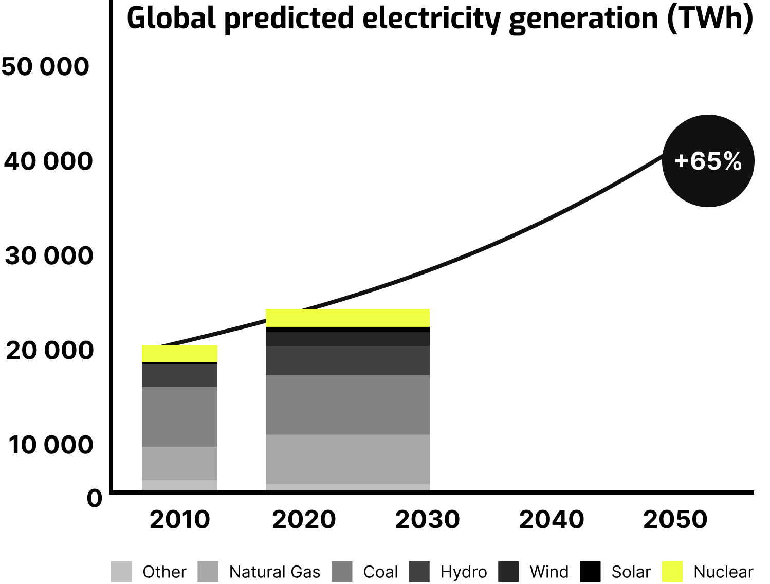
… at the same time as an energy crisis
Global demand for electricity is expected to grow by 65% in the next 30 years
Source: EIA’s International Energy Outlook 2021

Slide 4
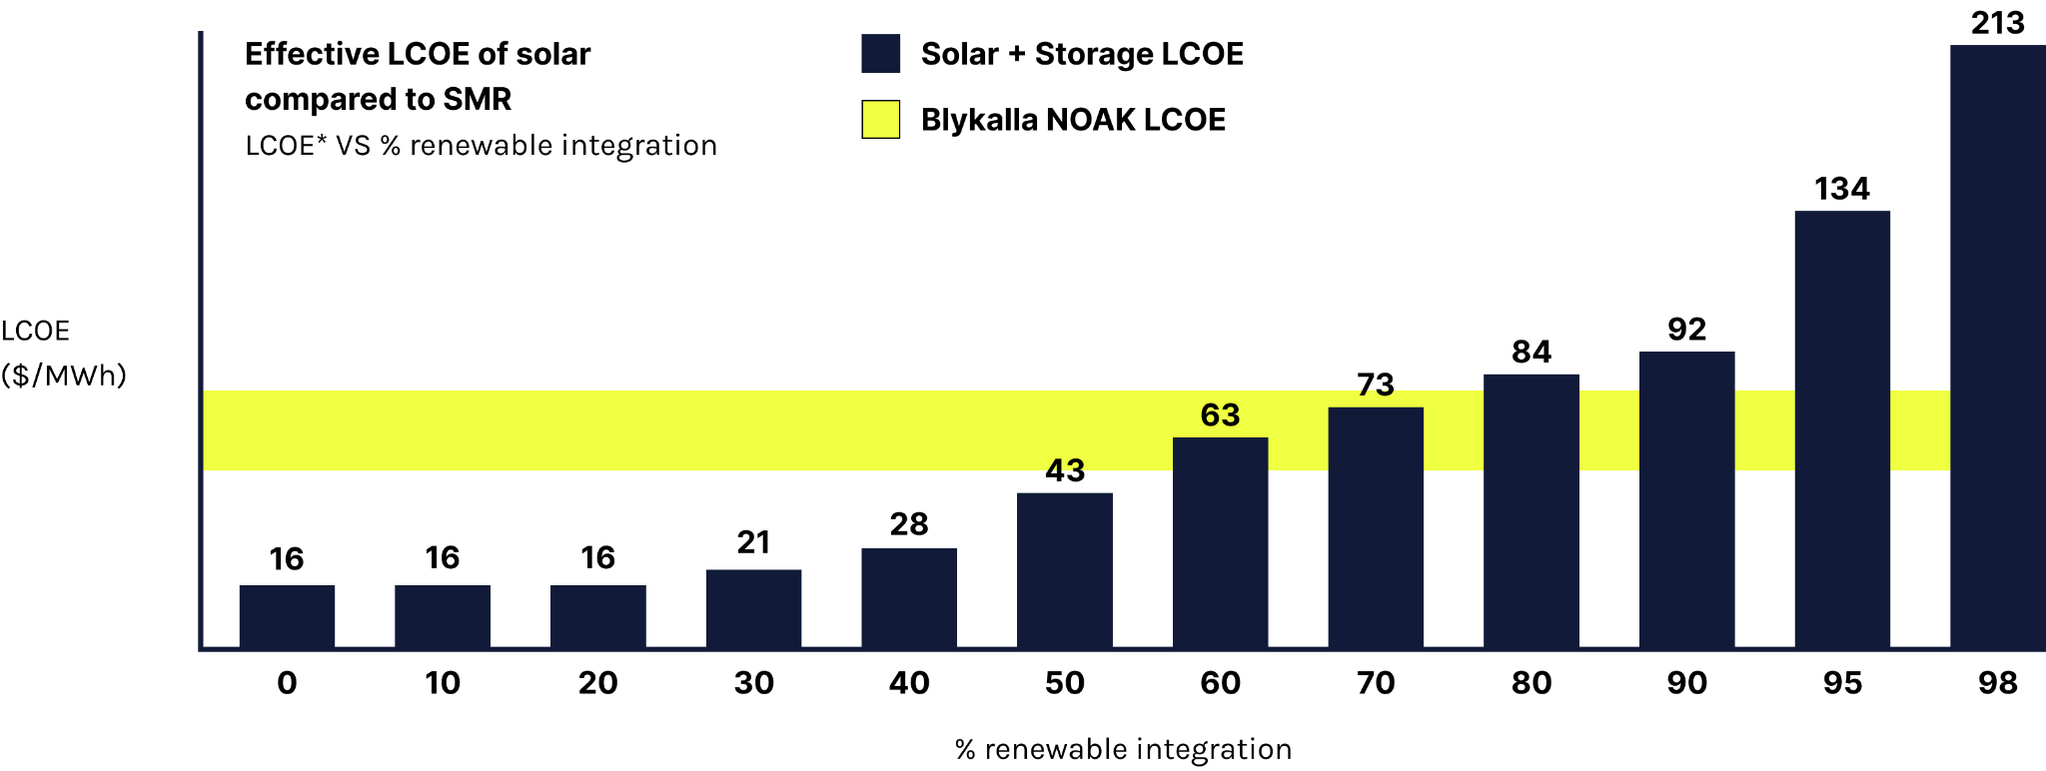
Renewables are one important answer, but need to be complemented with baseload to be economically viable
Source: McKinsey, University of Chicago – EPIC; McKinsey Power Solutions; Lazard, Levelized Cost of Energy and Levelized Cost of Storage – 2021
*: Power Solution model for solar penetration in to US grid; integrates cost of storage for renewable power

Slide 5
Historical concerns with nuclear are addressed with SMRs
Conventional nuclear
SMRs
RARELY ON TIME AND BUDGET
MODULAR AND FACTORY-BUILT
HUGE FINANCING NEEDS
STEP BY STEP FINANCING
ACTIVE SAFETY SYSTEMS
PASSIVE SAFETY (WALK AWAY SAFE)

Slide 6
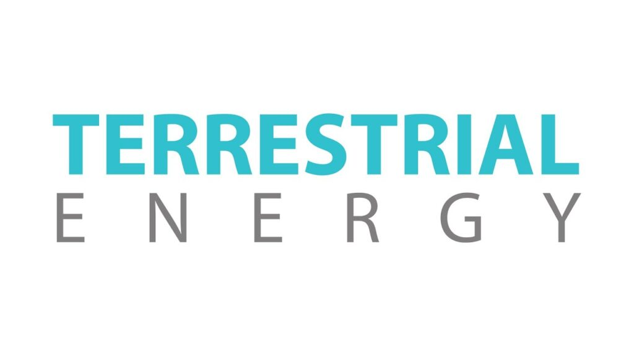
SMRs are categorized by coolant, with (light) water being the incumbent and liquid lead the most relevant next-generation challenger
Advanced designs
The benchmark: Water (LWR)
Helium
Sodium
Salt
Lead
25m
30m
12m
7m
5m

Slide 7
Lead-cooling offers relatively high technical maturity,
combined with a compact and cost-competitive design
Water
Sodium
Lead
Helium
Salt
Notes:
So let's start talking about coolant technologies.
Of course light water is the benchmark. And I know that research in the US around advanced reactor concepts has centered around sodium, molten salt and helium. You all know these, so I’m going to focus on the new kid on the block from a US perspective: lead
The thing is, in Europe, it’s actually not a newcomer. In fact, i think it’s the most popular advanced coolant technology for European startups. In addition to Westinghouse, we have two Italian concepts, one British and us, the only Swedish SMR developer. And there has been a major investment in this technology by the Russians, who has used it since the 80s for propelling the nuclear submarines. Russia is rightfully cut-off from the global markets today, but the science itself knows no borders.

Slide 8
All nuclear reactors are safe, but lead offers safety through its intrinsic properties
Notes:
So why lead? The biggest reason is really that lead allows for safety in the most compact format. Our reactor is 5m tall, that's 17 feet, LWR designs tend to be 4-5 times taller. This is because of the properties of lead as a coolant. For instance, we can achieve natural circulation, so passive safety, in case of a station blackout with this small vessel.
And why is it good to have a small reactor vessel? Cost for one thing. Having a small vessel means an easier supply chain, for instance there are many more suppliers who can do forging for you. It's also easier to manufacture everything in a factory and just transport it to the site.
Even more importantly, lead has many attractive safety properties, which in effect strengthens the first layers of the defense-in-depth concept. For instance, LOCA accidents are very unlikely since the boiling point of lead is 1700 degrees C. You don’t need a pressure vessel, you don’t have zirconium so you avoid the risk of hydrogen explosions, and of course lead is a perfect radiation shield. Worst case, you cover the core with 800 tonnes of lead. Also, lead chemically binds to active particles.
And of course, lead doesn't have some of the challenges that you see with other coolants, that have made them complicated and expensive to commercialize

Slide 9
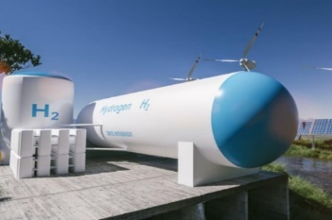
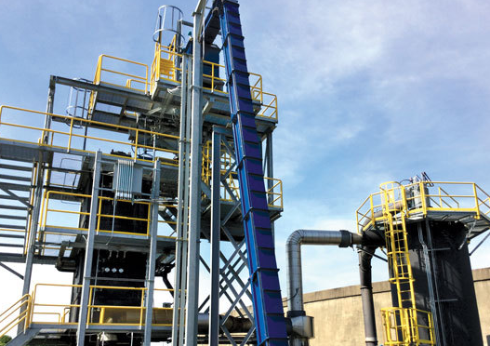
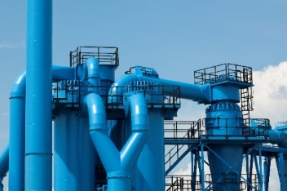
Also, the high-temperature steam from lead-cooling gives a significantly better business case for industrial applications
530°c steam
Hydrogen gas production
HVO, syngas and bio-char production
Heating applications
Notes:
Similar to other advanced designs, steam from our reactor is high temperature, 530 degrees C or 1000 degrees F. This means it can be used for electrolysis to make hydrogen much more effectively than with traditional nuclear, pyrolysis to make biofuels, district heating and other industrial processes.

Slide 10
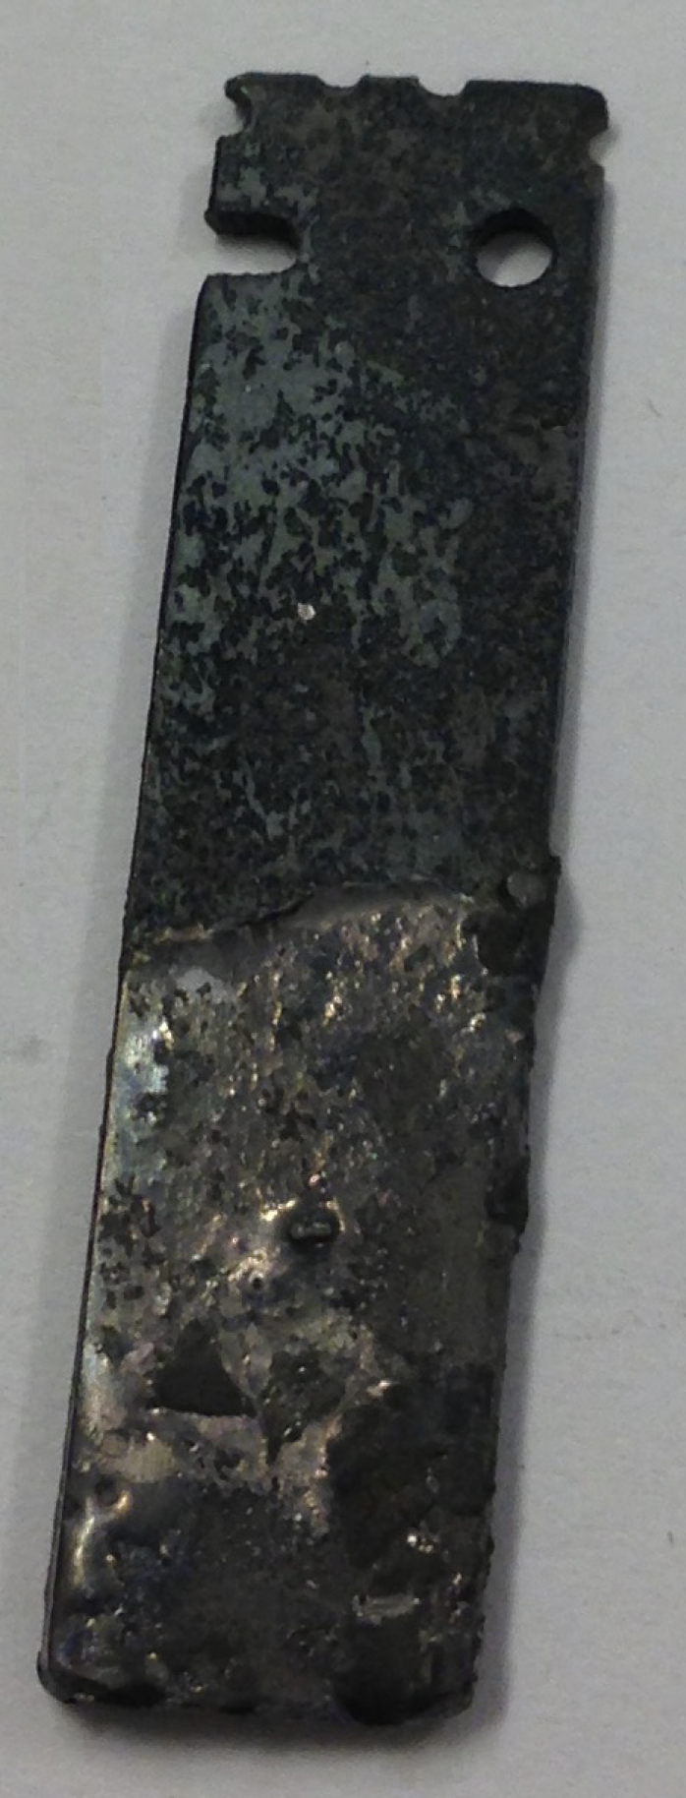
The main drawback with liquid lead is that it corrodes
stainless steel – and, until now, that been hard to solve
Solving this is one of three big innovations underpinning our company
Notes:
The main drawback with liquid lead is that it corrodes stainless steel
Historically, that been hard to pretty fix
There is a well-known short-term solution for smaller segments, where you inject oxygen and form a semi-protective iron-chromium oxide layer on the surface.
Oxygen control is absolutely required, and can be implemented in smaller reactor vessels, such as ours. However the iron-chromium oxide forming on surface of conventional steels is not sufficient for managing corrosion at temperatures above 420°C beyond a year of operation.
And cracking this is one of three innovations behind our company

Slide 11
Our commercialization centers around our three unique assets
.Three different corrosion-tolerant steels.
A compact reactor design
Proprietary uranium nitride fuel.

Slide 12
Phase 1: By end of 2024, we will have completed the design and started building the pilot
1. Pilot
‘22
‘23
‘24
‘25
‘26
‘27
‘28
‘29
‘30
‘31
‘32
W4
Phase 1: Design and construct an electrical test reactor in Oskarshamn
Tests + commercial electrolysis
Design starts
Construction starts
Commissioning

Slide 13
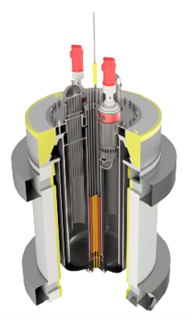
We are building the pilot together with Uniper
Sealer-E
Electrical prototype
Notes:
Right now we are doing two things.
We are building an electrical prototype, to validate the safety concept and certain components. This is done together with Uniper, one of the largest European utilities -- they have 34 GW of generation capacity -- at their Oskarshamn nuclear site in Sweden. We expect this to be completed next year.

Slide 14
This has been partly funded (SEK 99m)
by the Swedish Energy Authority
“
SEALER has the potential to develop into a cost-effective, reliant base power and thus be able to contribute to electrification in the energy transition.
The Energy Authority assesses that, in the long run, SEALER has the potential to be commercialized on a global market, […and] contribute to industry development in Sweden.
Swedish Energy Authority, 2022

Slide 15
Phase 2: Also, by the end of 2024, we will have commenced phase 2, by submitting a license application for Sweden’s next nuclear reactor
1. Pilot
2. Sweden’s next nuclear reactor
‘22
‘23
‘24
‘25
‘26
‘27
‘28
‘29
‘30
‘31
‘32
W4
Phase 1: Design and construct an electrical test reactor in Oskarshamn
Tests + commercial electrolysis
Design starts
Construction starts
Commissioning
Prepare
Phase 2: Build an 80 MW reactor in Sweden
Operations
License application submitted
License approval expected, construction starts
Commissioning

Slide 16
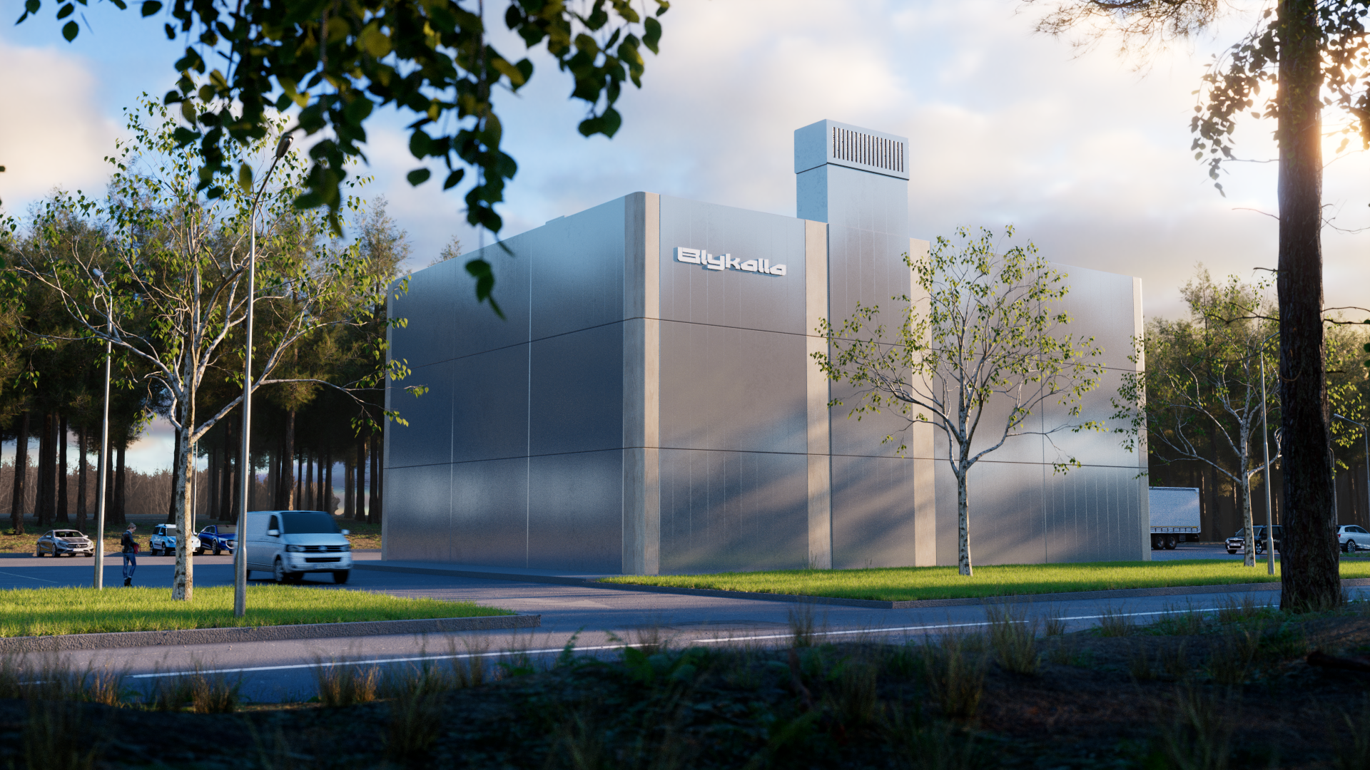
Our first nuclear reactor will likely be used
for nuclear pyrolysis or another industrial process
Notes:
And after that, we will start with our first nuclear reactor.
We are planning to finance this through building an adjacent py'rolysis plant. The business case for running that on our 530 degrees steam looks really promising. This will also give us the learnings we need to prove to the regulator that our concept can be used for a nuclear power plant.
We aim to reach criticality by 2029.

Slide 17
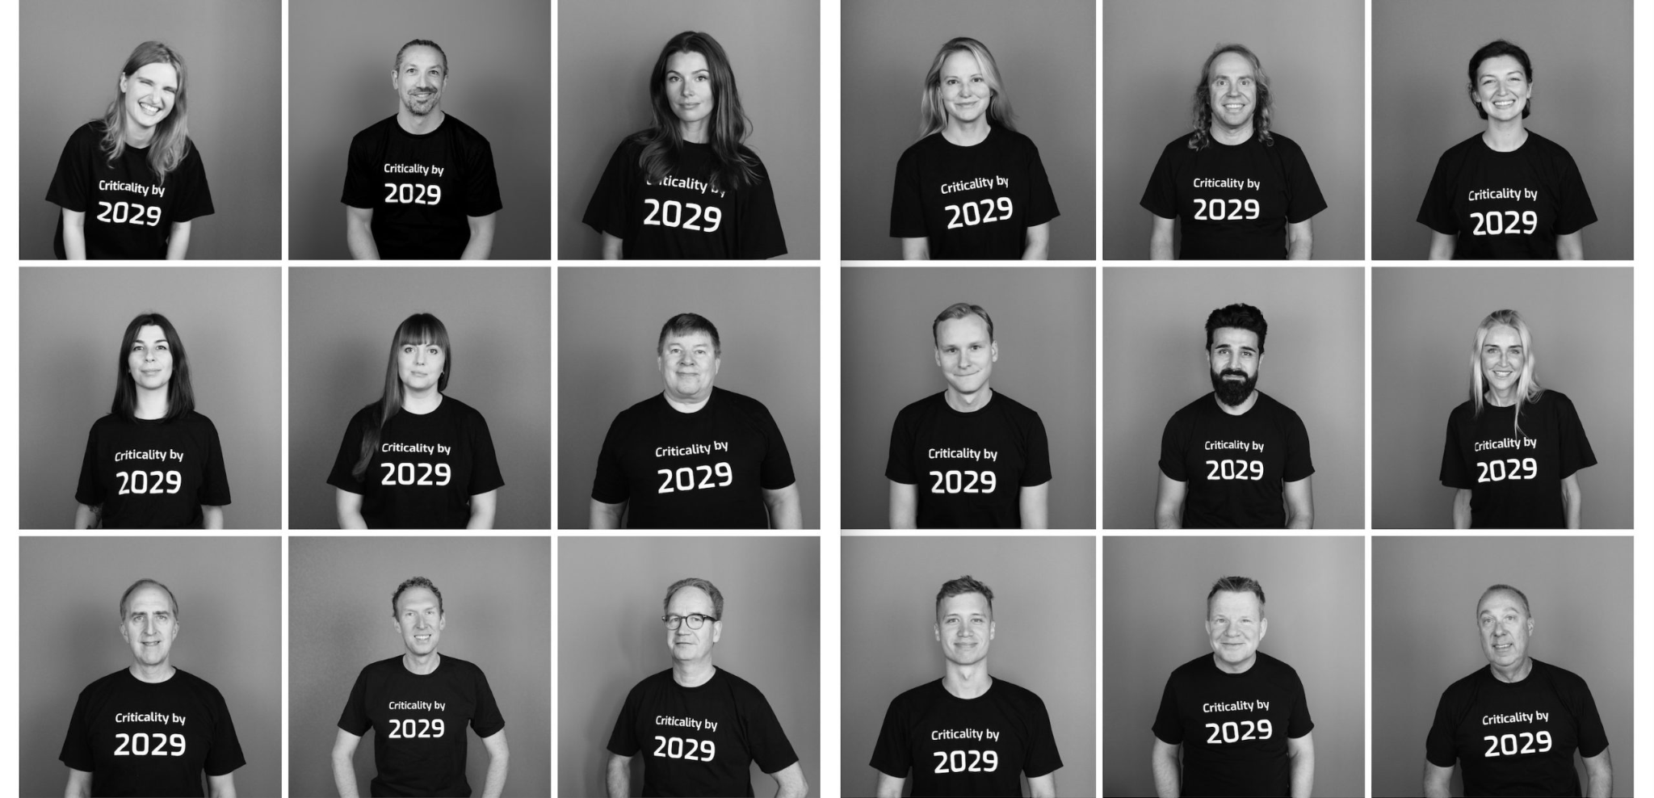
Expected criticality by 2029

Slide 18
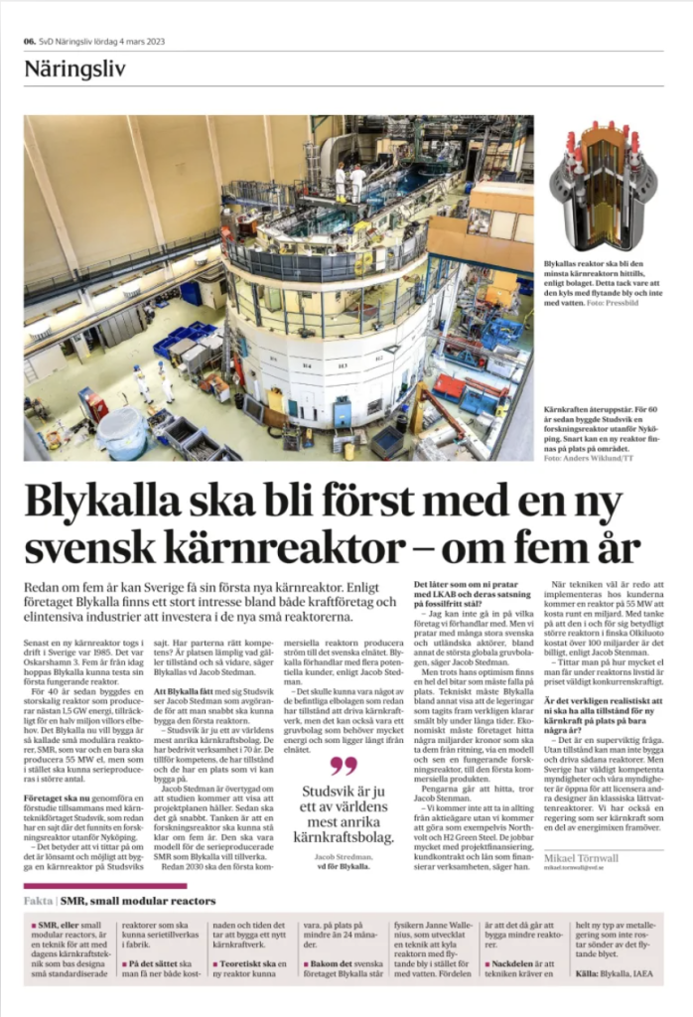
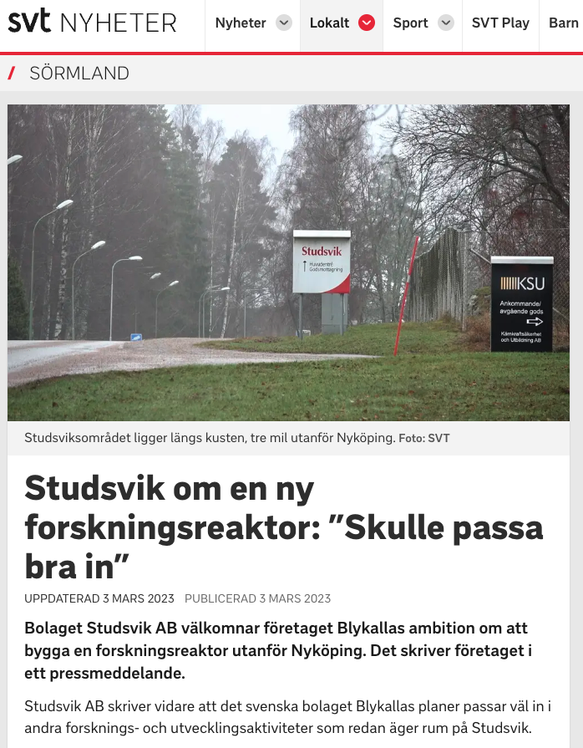
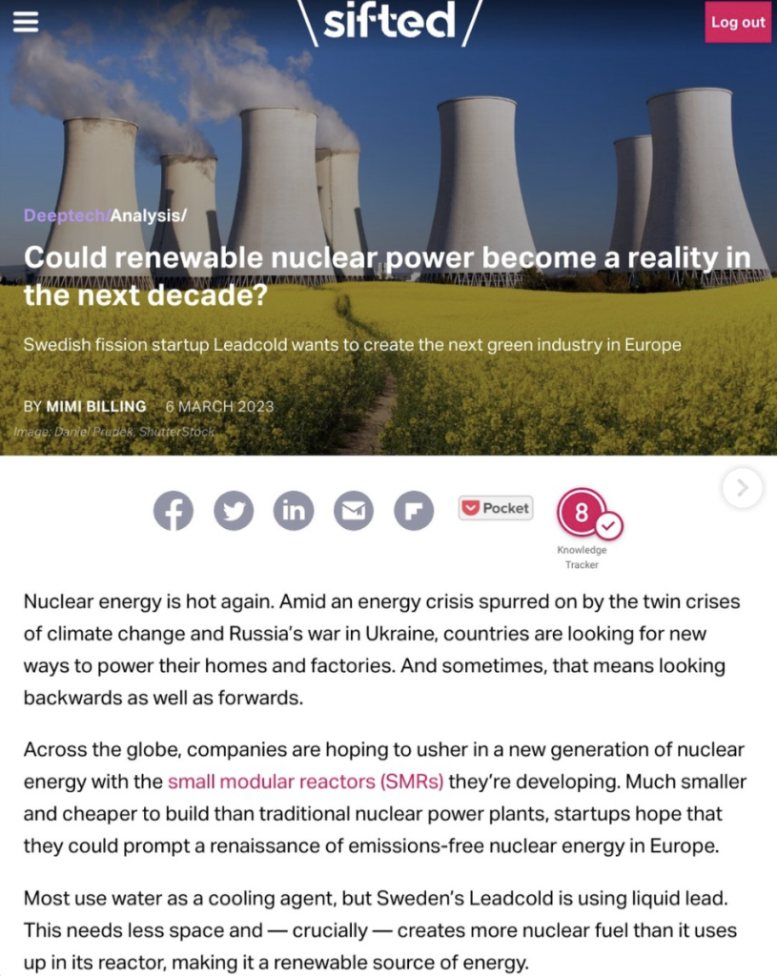
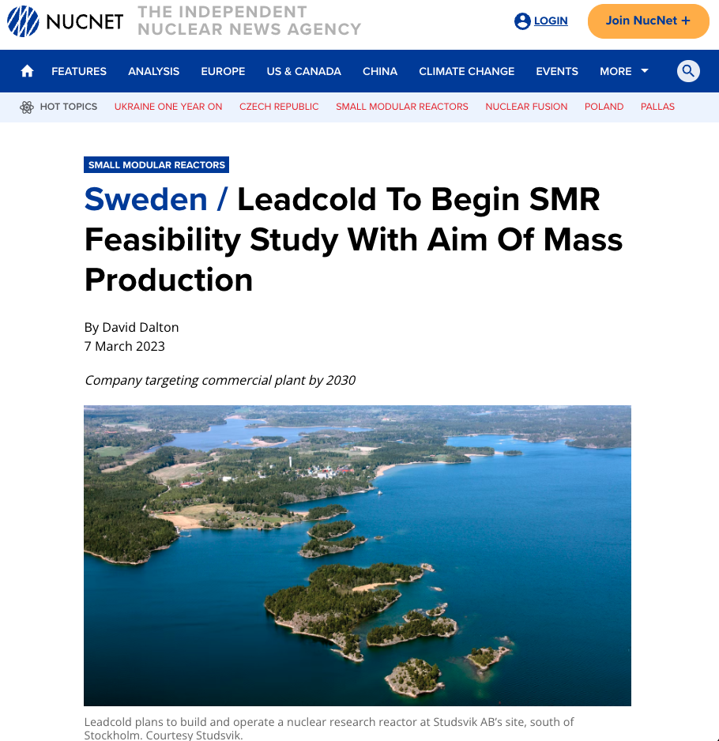
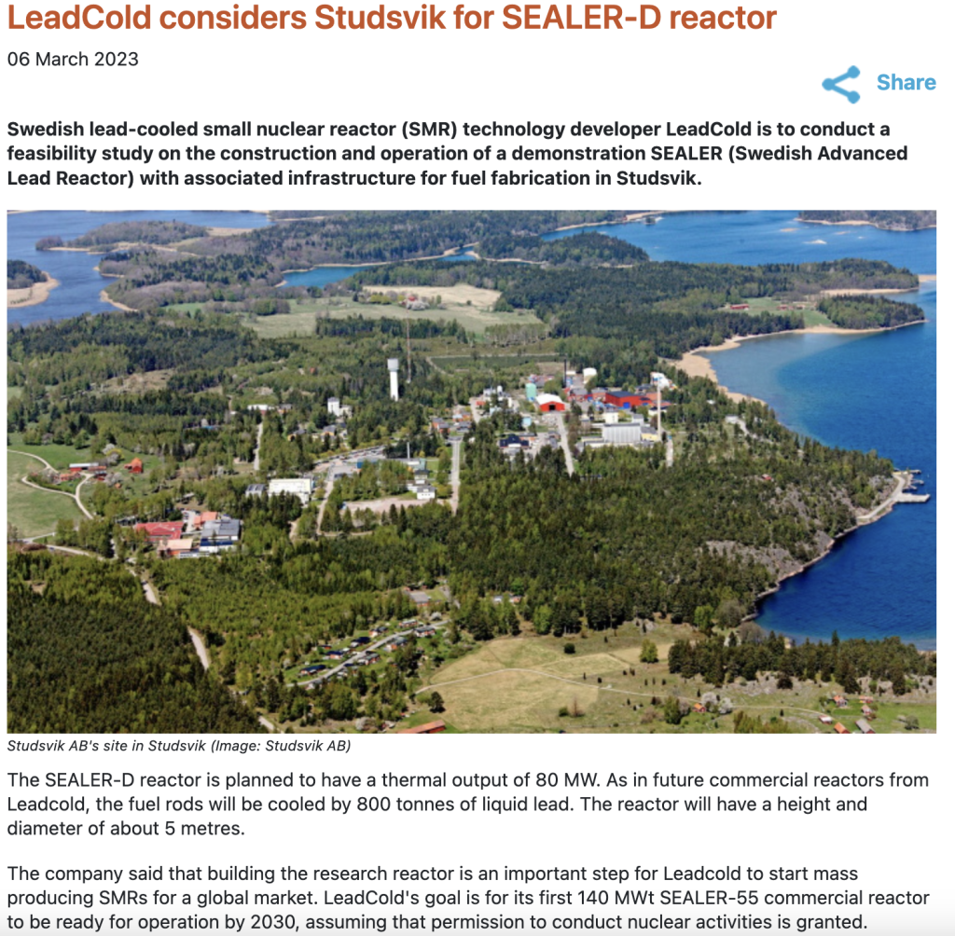
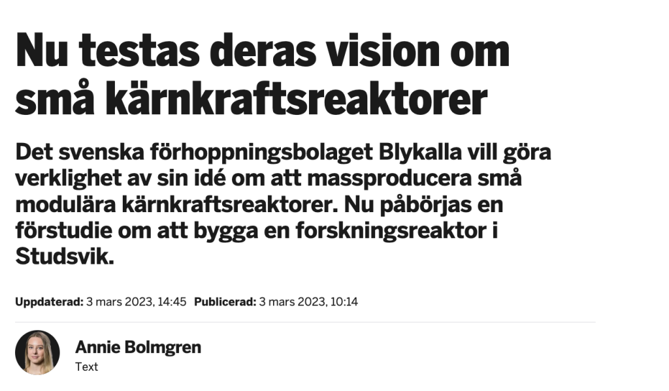

Slide 19
Phase 3: Mass production
1. Pilot
2. Sweden’s next nuclear reactor
3. Mass production
‘22
‘23
‘24
‘25
‘26
‘27
‘28
‘29
‘30
‘31
‘32
W4
Phase 1: Design and construct an electrical test reactor in Oskarshamn
Tests + commercial electrolysis
Design starts
Construction starts
Commissioning
Prepare
Phase 2: Build an 80 MW reactor in Sweden
Operations
License application submitted
License approval expected, construction starts
Commissioning
Phase 3: Manufacture SMRs for energy companies and industrials

Slide 20
Our goal is to build 1 000 SMRs. Together they will produce close to 500 TWh of electricity per year. If successful, we will avoid 0.5 gigatons of C02
= 1% of global emissions, every year.

Slide 21
Criticality by 2029 – we are building Sweden’s next nuclear reactor

