Slide 1
Welcome to the world of Hardt Hyperloop
Cleantech Capital Day - Hardt Hyperloop

Slide 2
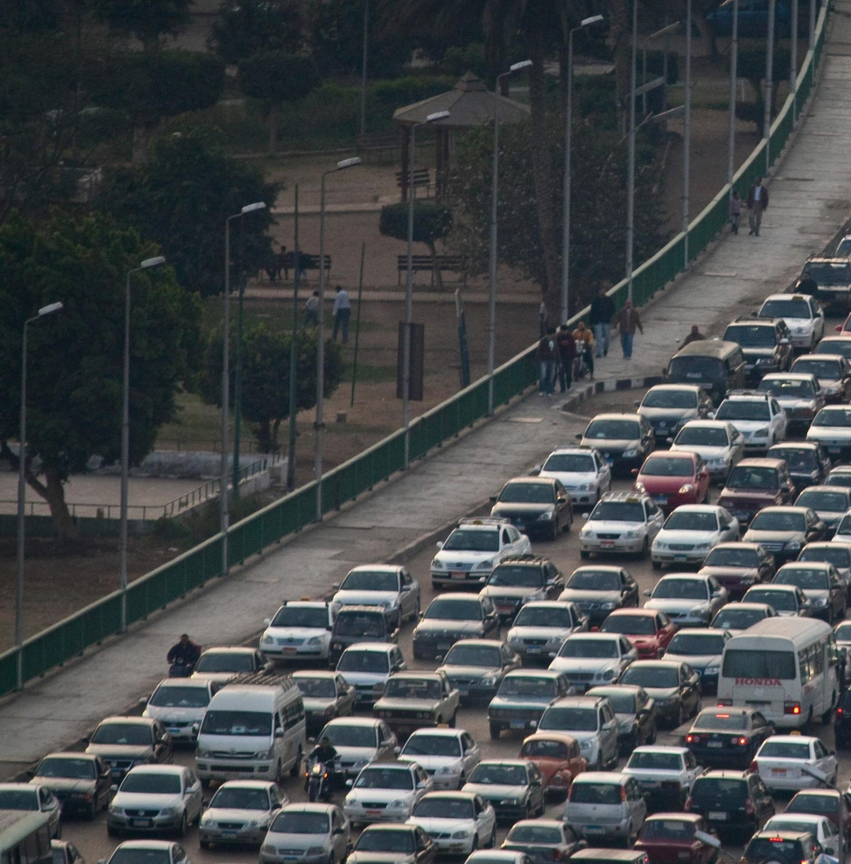
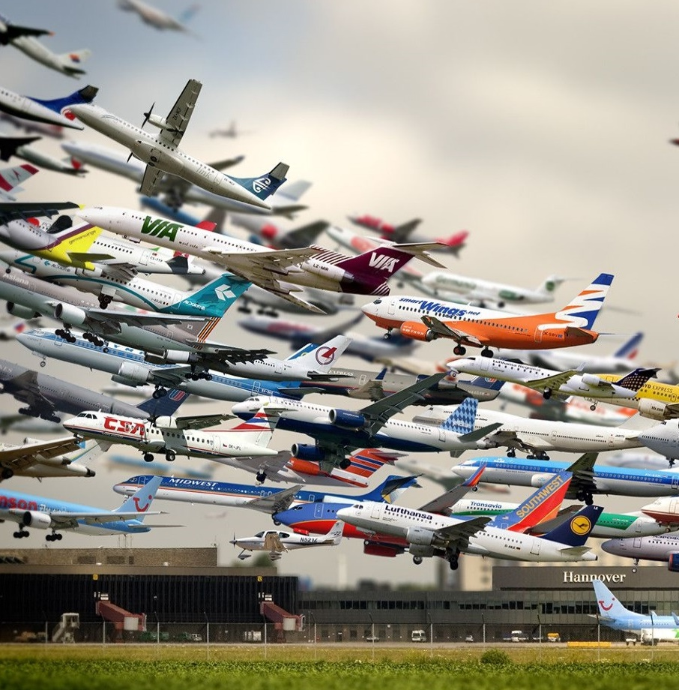
Transport demand will grow
2.5x by 2050
Building the same roads, rails and airports
will not solve our problems

Slide 3
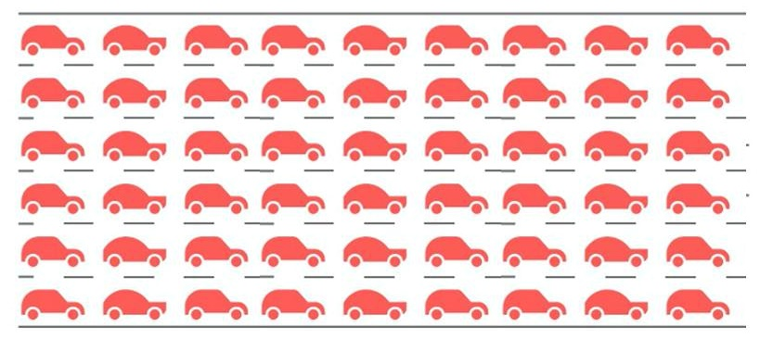
If this is
the problem…
… then this isn’t
the solution.
This is!

Slide 4
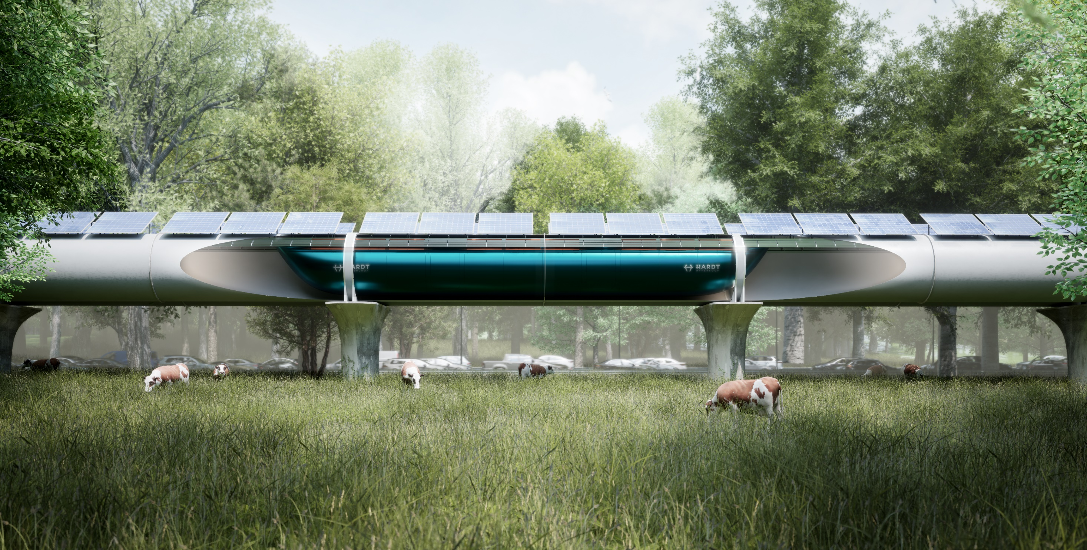
Low
Pressure
Magnetic
Suspension
Static
Infrastructure
10x less
energy than
cars/planes
>30%
shorter
payback

Slide 5
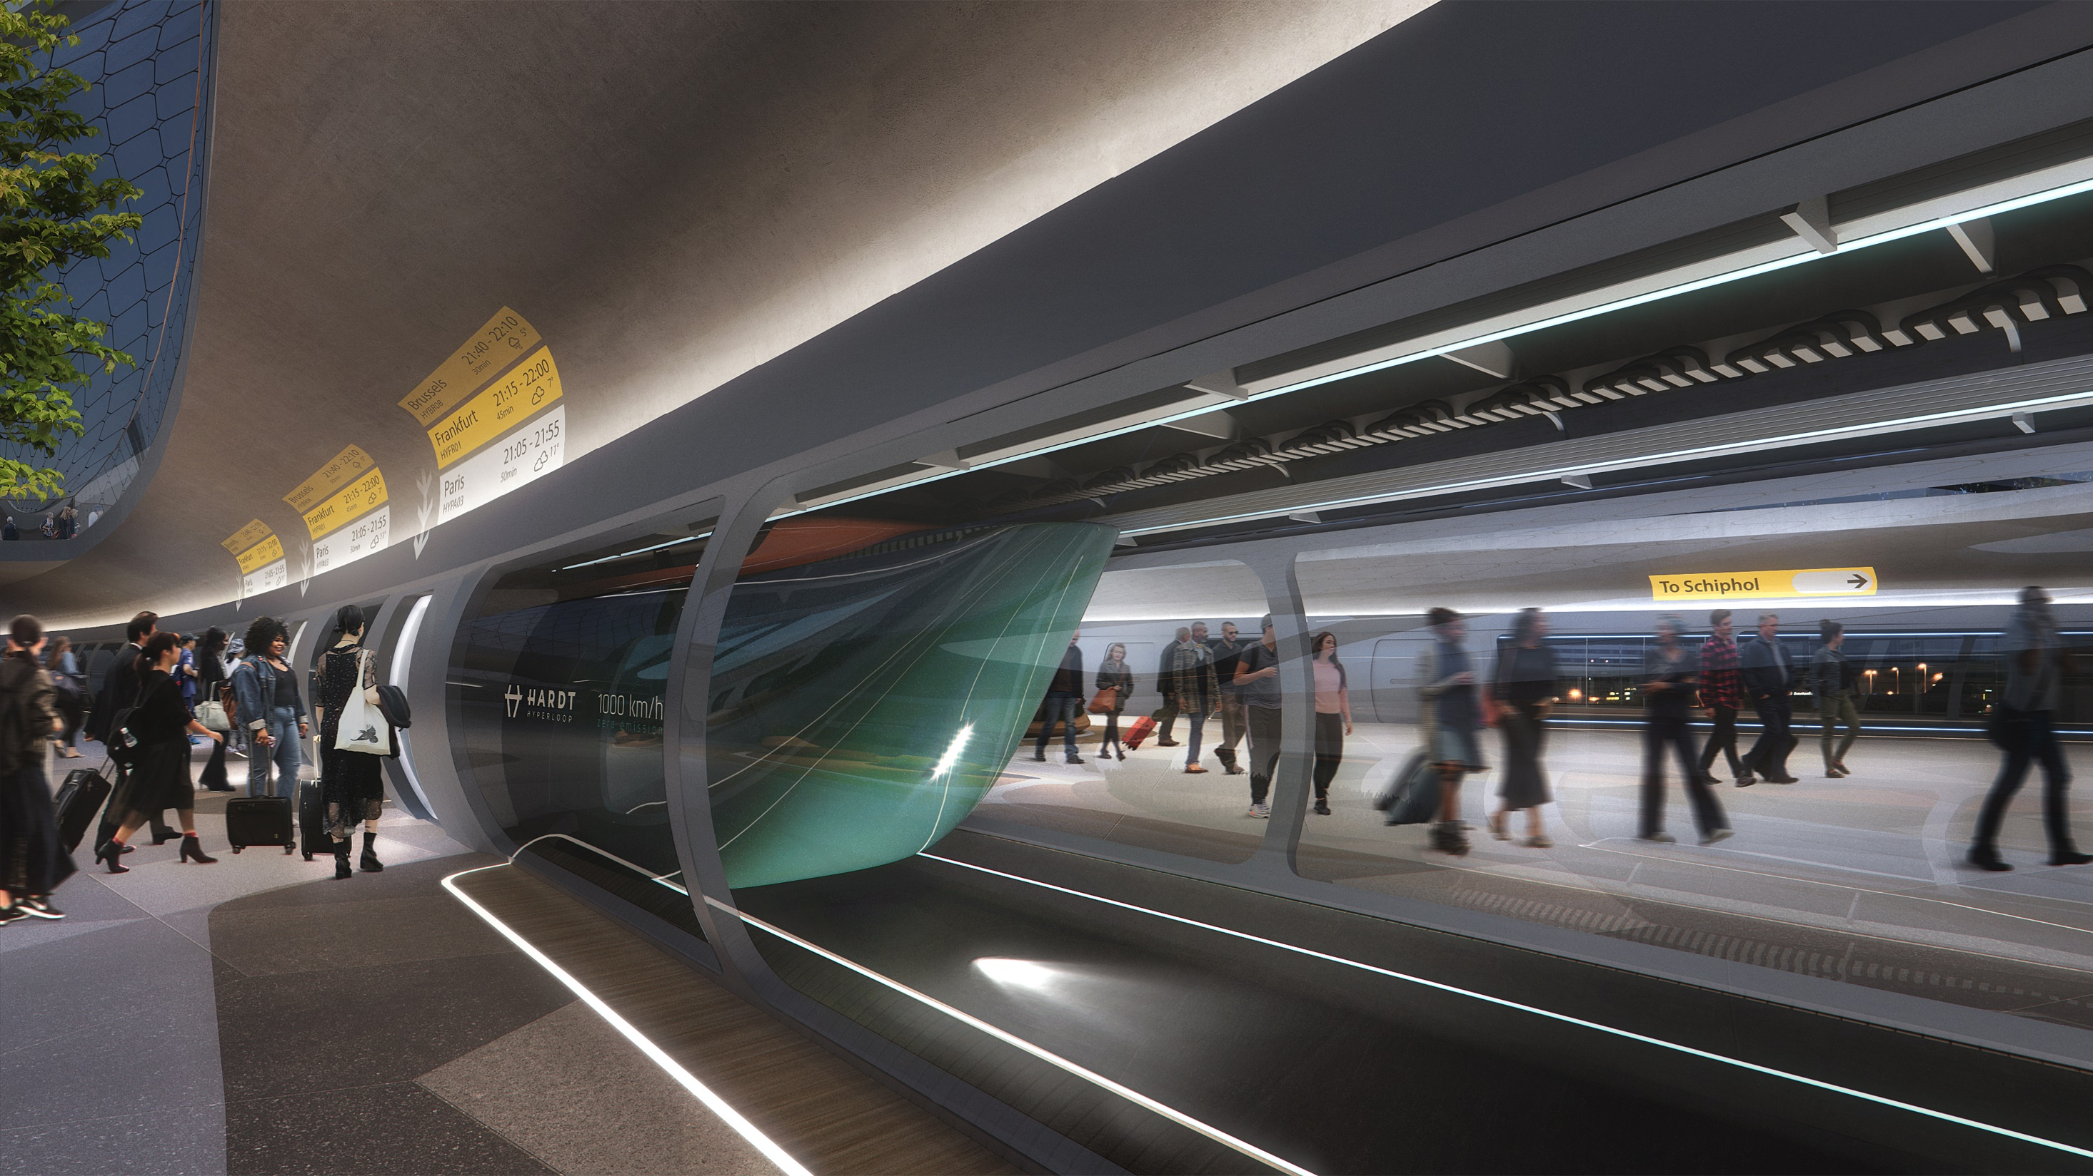
For passengers: frequent, fast and flexible
leave every 5 minutes for every large city at 700km/hr

Slide 6
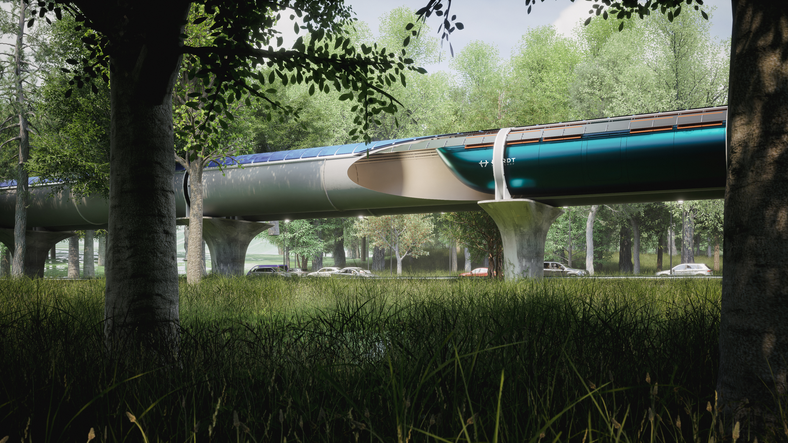
For governments it beats roads, trains and planes environmentally friendly, easy to implement and >30% shorter payback

Slide 7
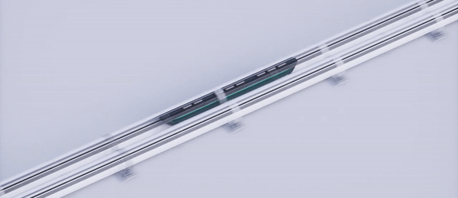
Static infrastructure enables
Network effects

Slide 8
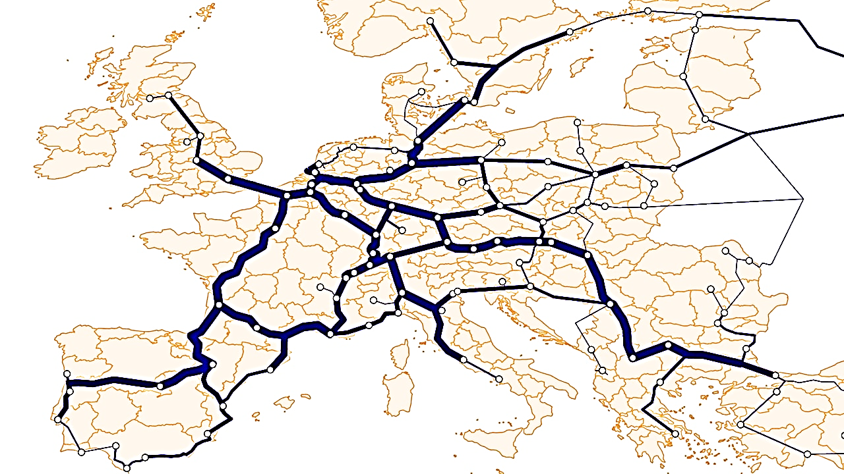
Scalable network
3 hours

Slide 9
Scalable network
3 hours
1 hour

Slide 10
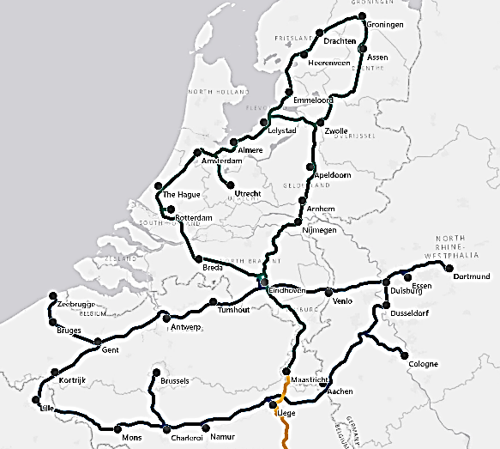
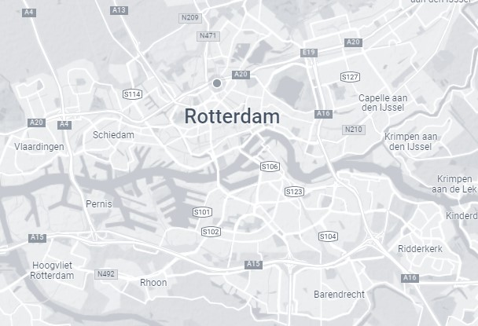
Scalable network
3 hours
1 hour
Support from 10+ EU cities
In policy at every level
€25M public support
15 minutes

Slide 11
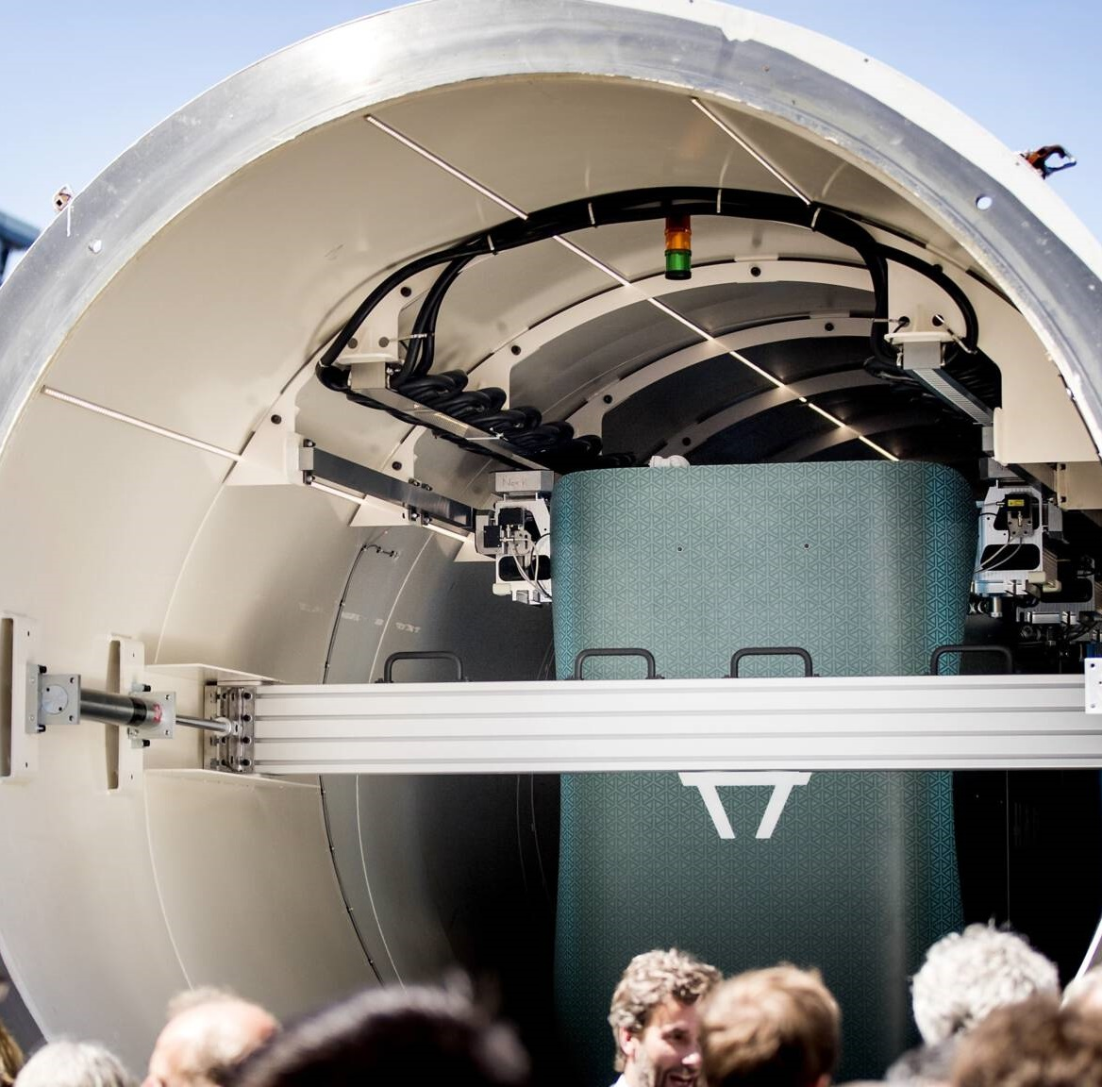
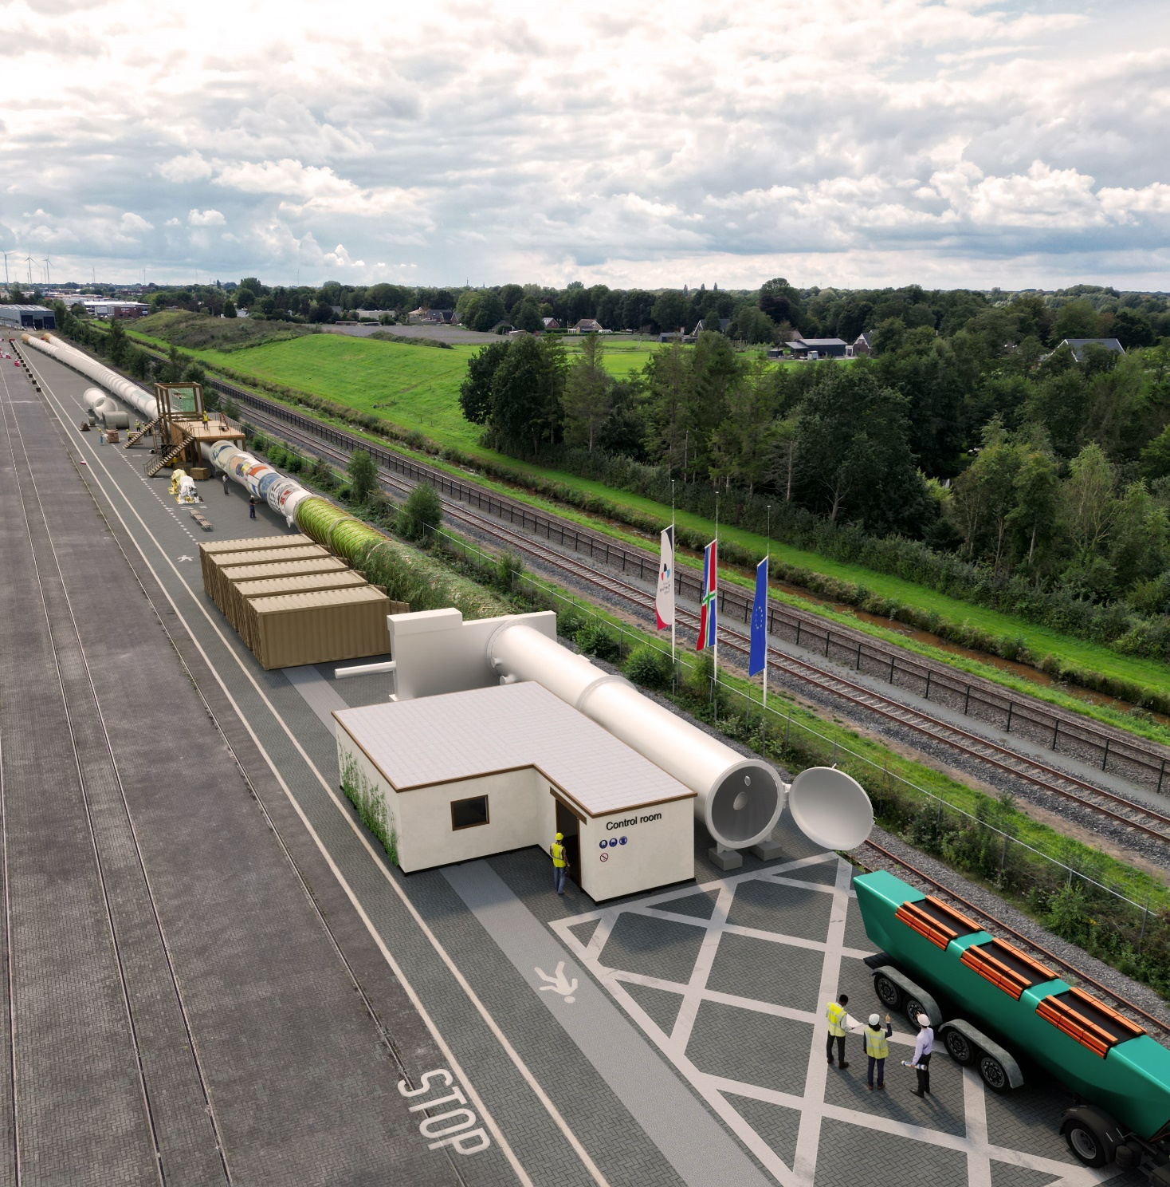
Built Europe’s first hyperloop test facility
Building the
European Hyperloop Center
Basis for the
Global Hyperloop Standard

Slide 12
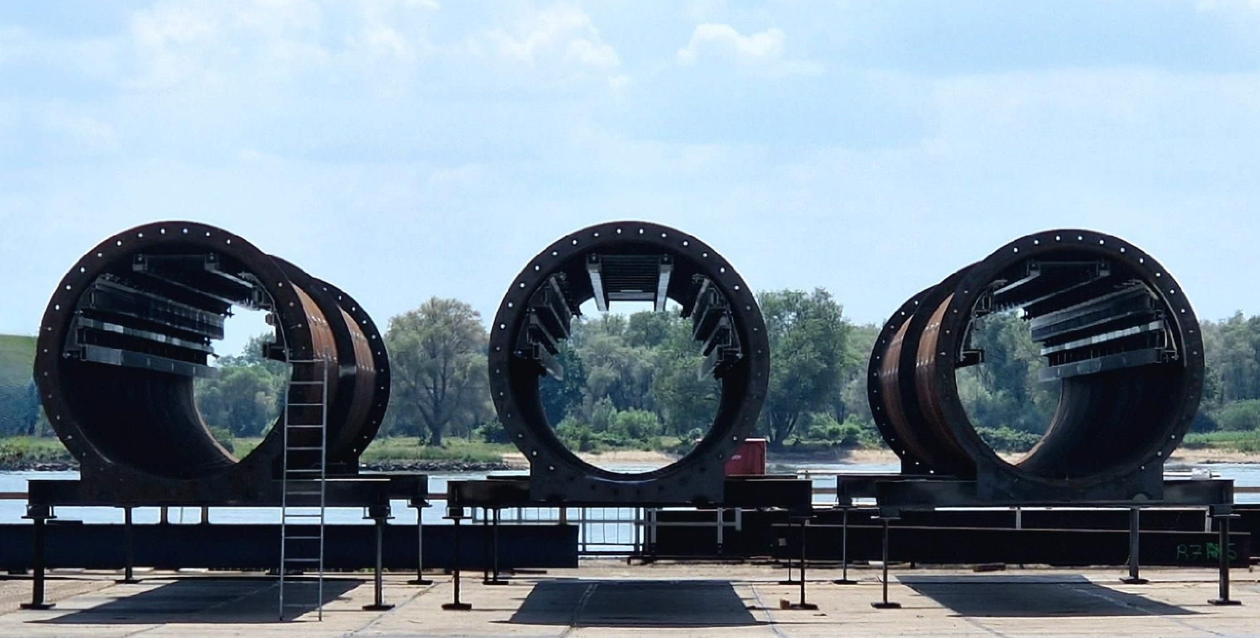
Any government can build the guideways
Using the open infrastructure standard

Slide 13
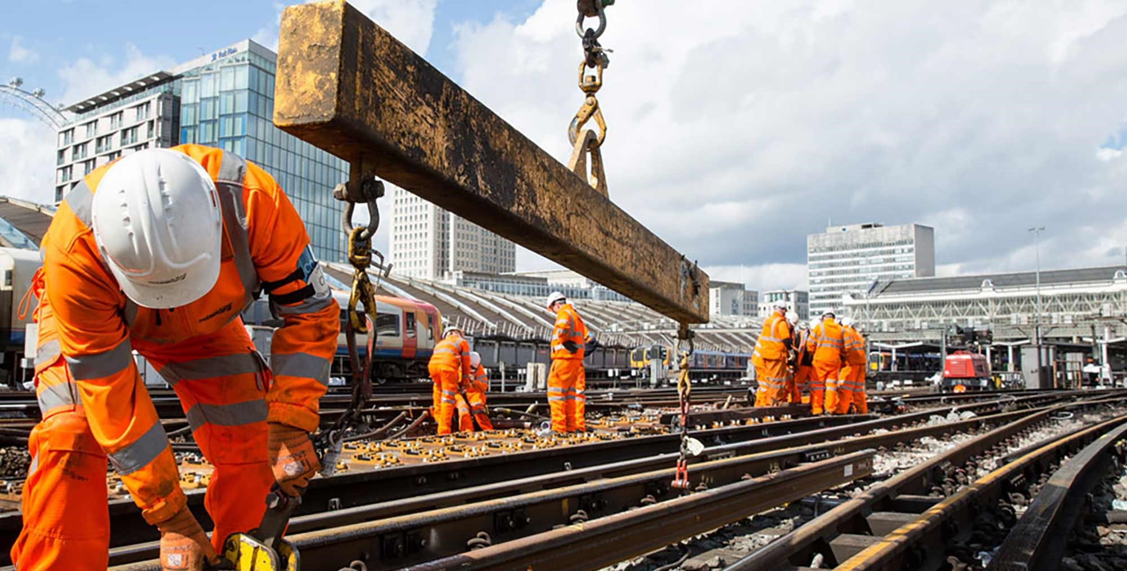
Annual investment in rail: €700 billion
€150bn hyperloop market potential

Slide 14
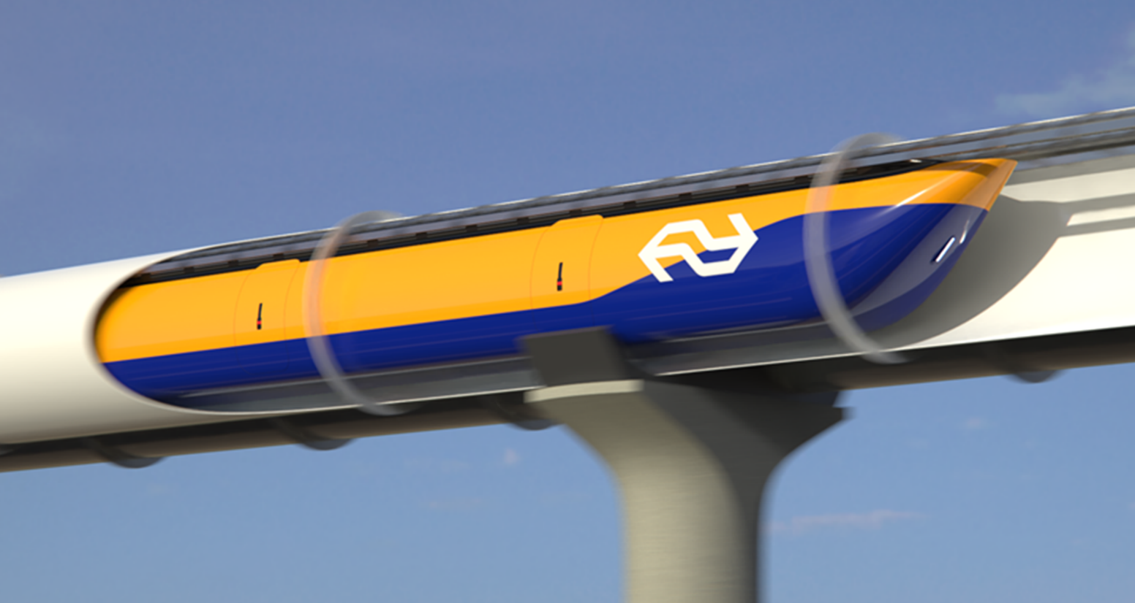
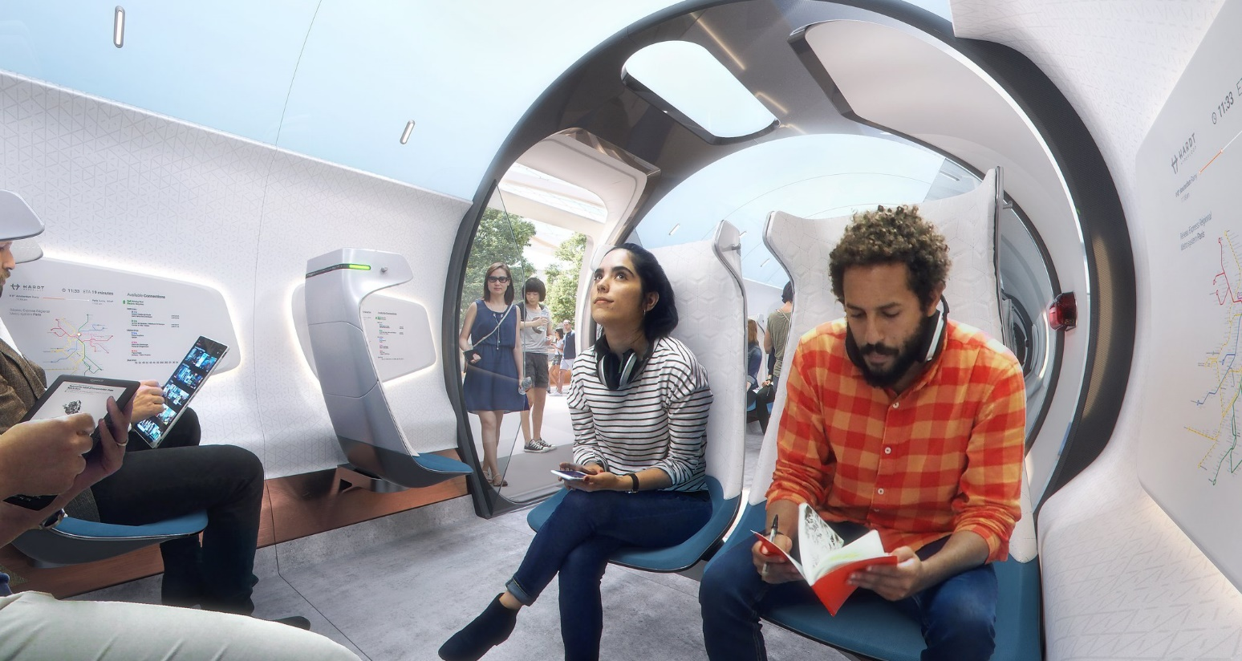
Hardt supplies
Hyperloop vehicles
High
Tech
High
Barriers
Attractive
Margins
€700k revenue to date
First pilot by 2030
€3B revenue from 2040

Slide 15
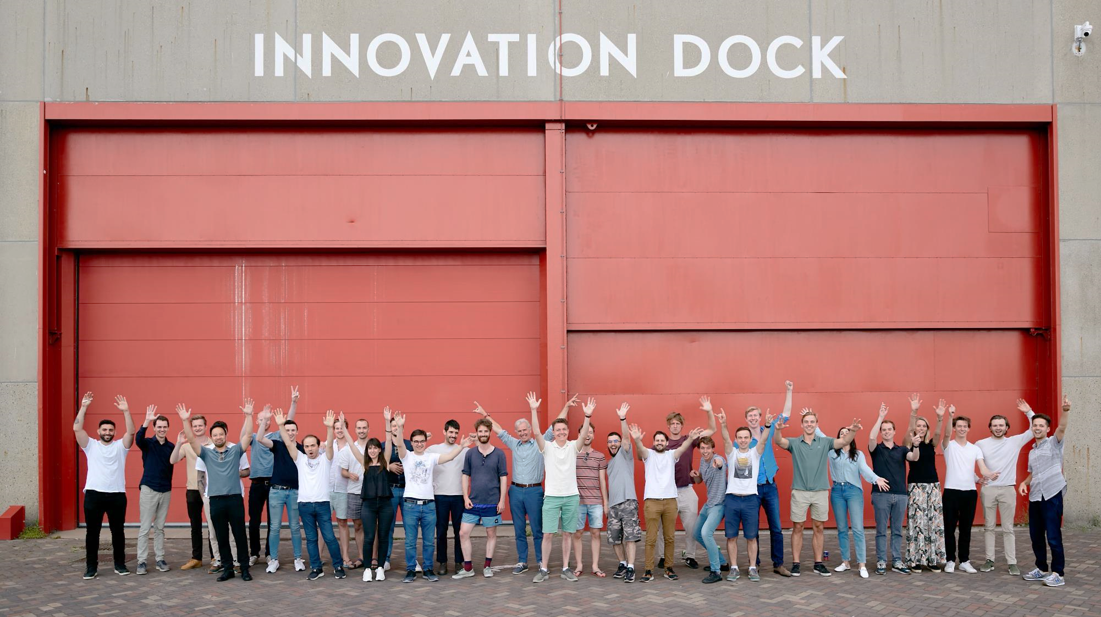
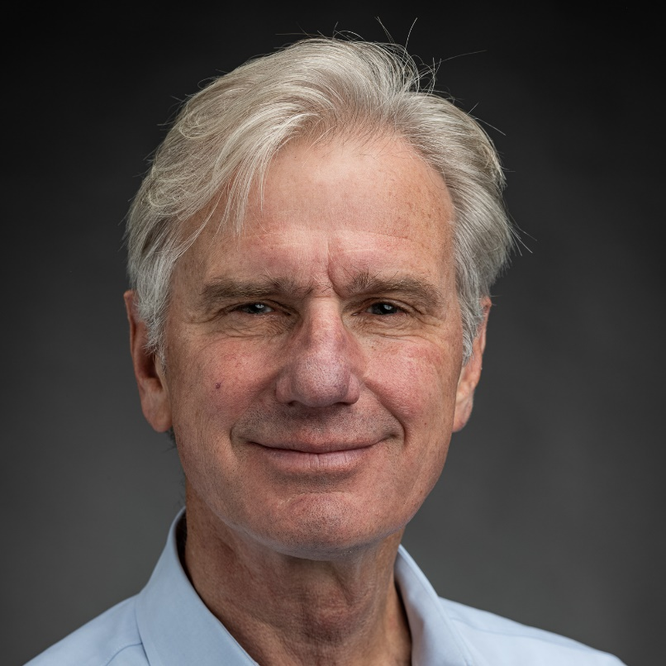
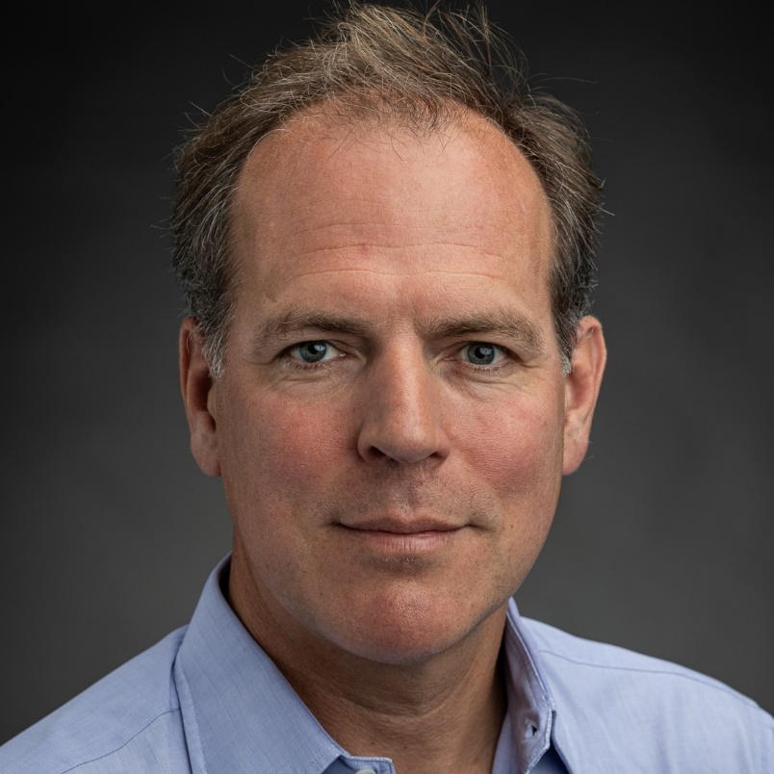
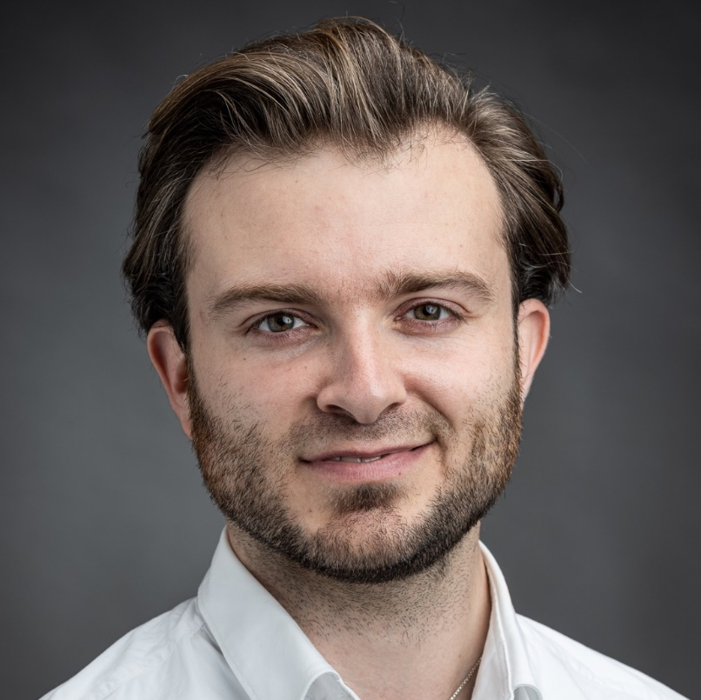
Bertrand van Ee
CEO
Marnix van der Kleij
CFO
Mars Geuze
CHO
(Chief Hyperloop Officer)
40+ years transport project realization
Scaled & exited 8 companies €250m+ proceeds
Co-Founder &
Winner 1st hyperloop competition

Slide 16
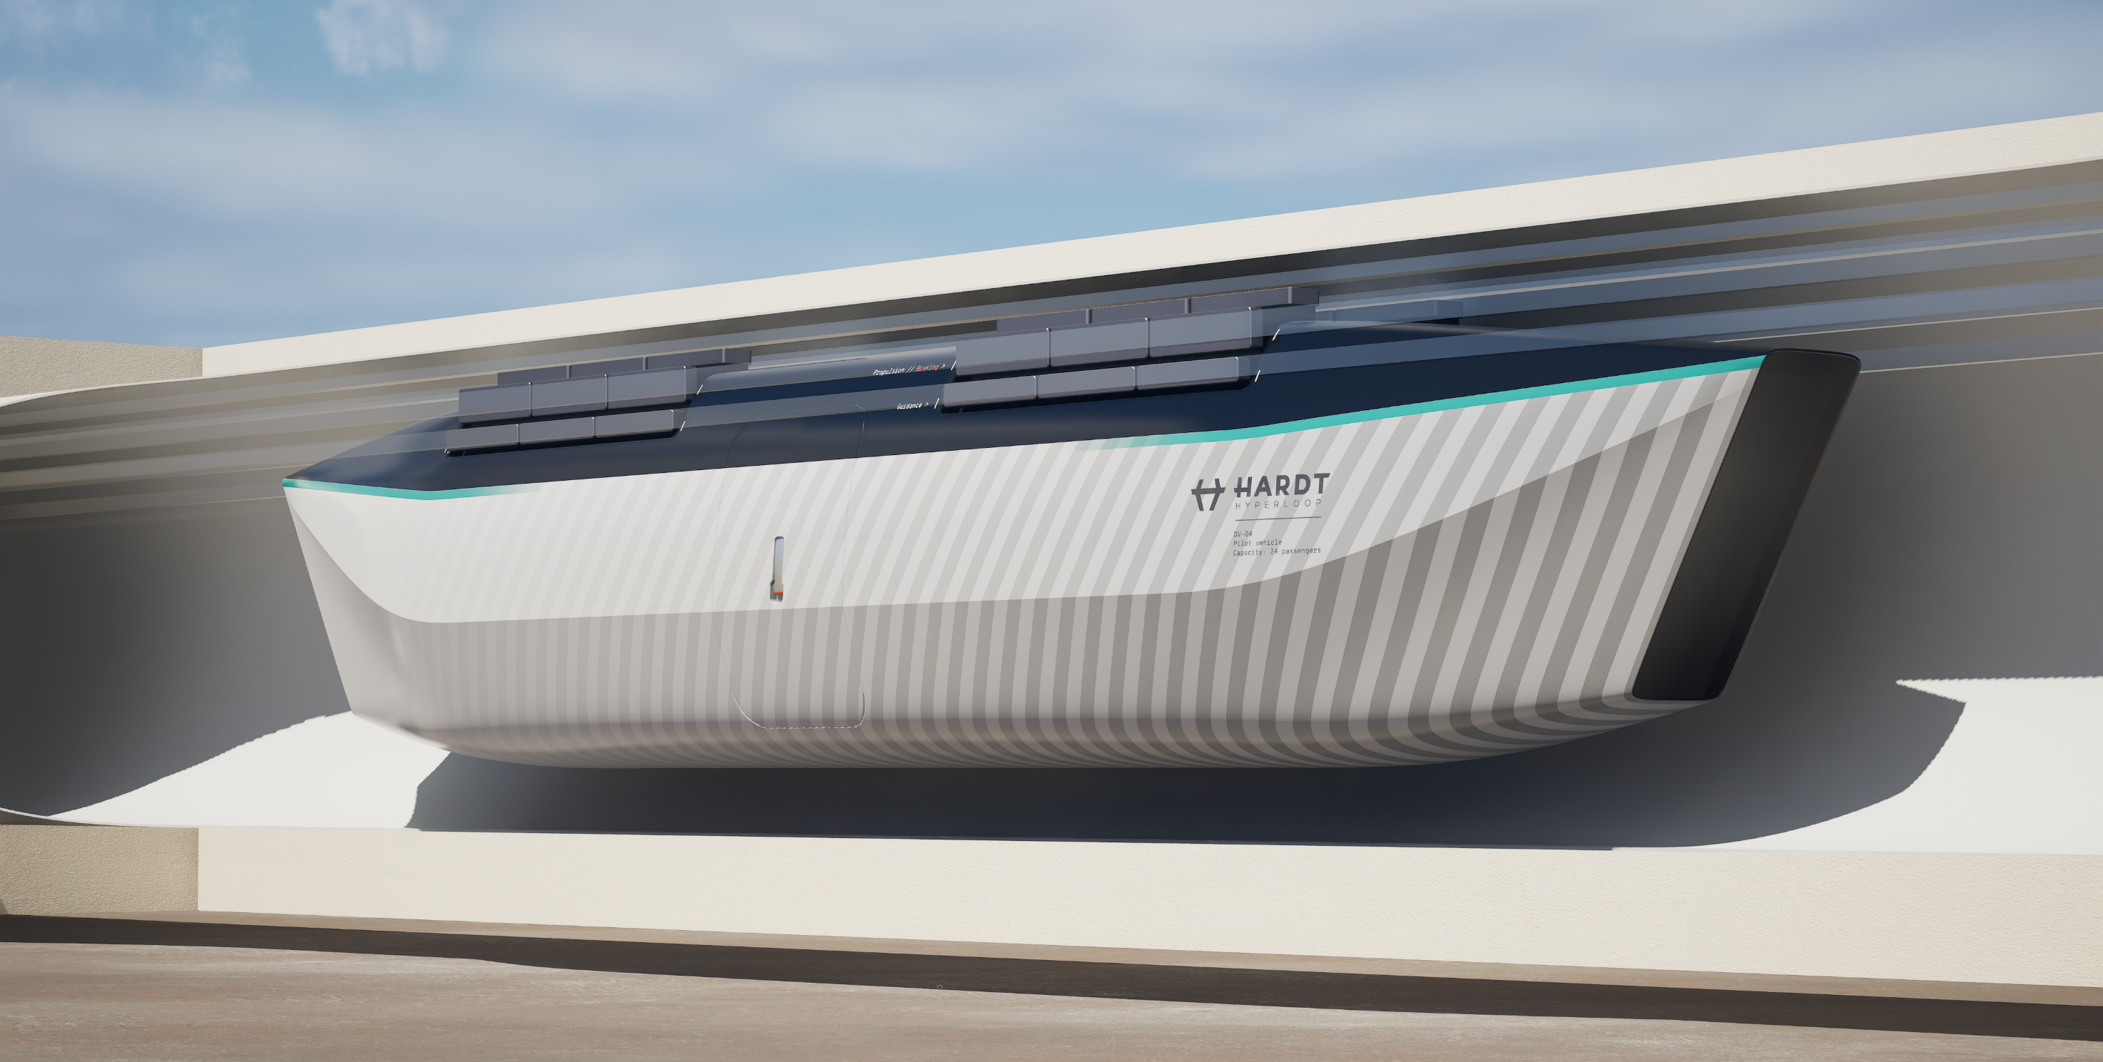
We are raising
€15-20 million by mid-2024
20% discount for early backers
€10M already committed
We are raising
€20 million in 2024
We will build a passenger vehicle prototype
To build a fully functional hyperloop prototype
Exit within 5-10 years at >10x
(large order book)

Slide 17
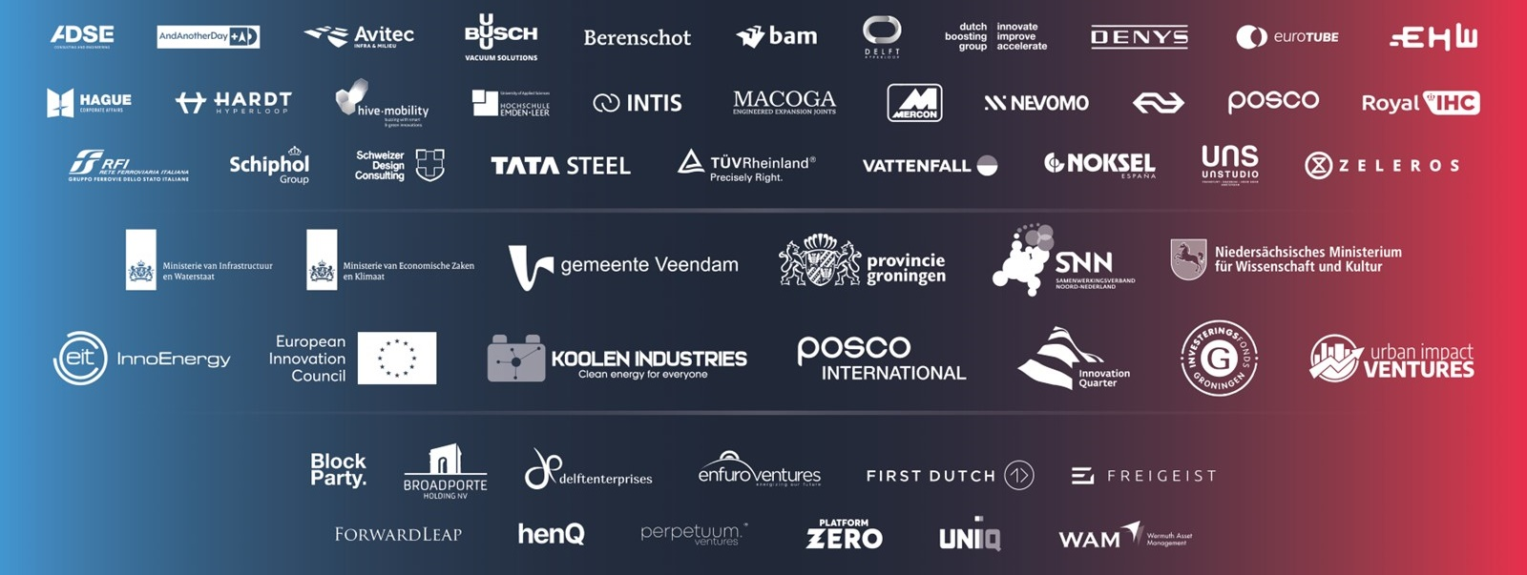
Join us…
… and let’s make hyperloop happen!

