Slide 2
USD 1,000,000 000,000

Slide 3
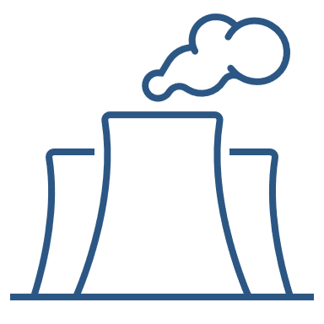
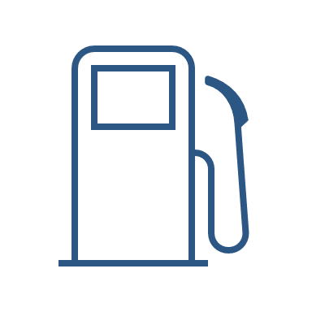
Biogas + Carbon Capture and Storage = Low Hanging Fruit
Concentration of CO2 in different sources
~98 %
0.004 %
~10 %
Direct air capture
Atmosphere (air)
Post combustion CO2 capture
Flue gas
Biomethane production
Off-gas

Slide 4
Biogas + Carbon Capture and Storage = Low Hanging Fruit
Concentration of CO2 in different sources
~98 %
0.004 %
~10 %
Direct air capture
Atmosphere (air)
Post combustion CO2 capture
Flue gas
Biomethane production
Off-gas

Slide 5
Biogas + Carbon Capture and Storage = Low Hanging Fruit
Concentration of CO2 in different sources
~98 %
0.004 %
~10 %
Direct air capture
Atmosphere (air)
Post combustion CO2 capture
Flue gas
Biomethane production
Off-gas

Slide 6
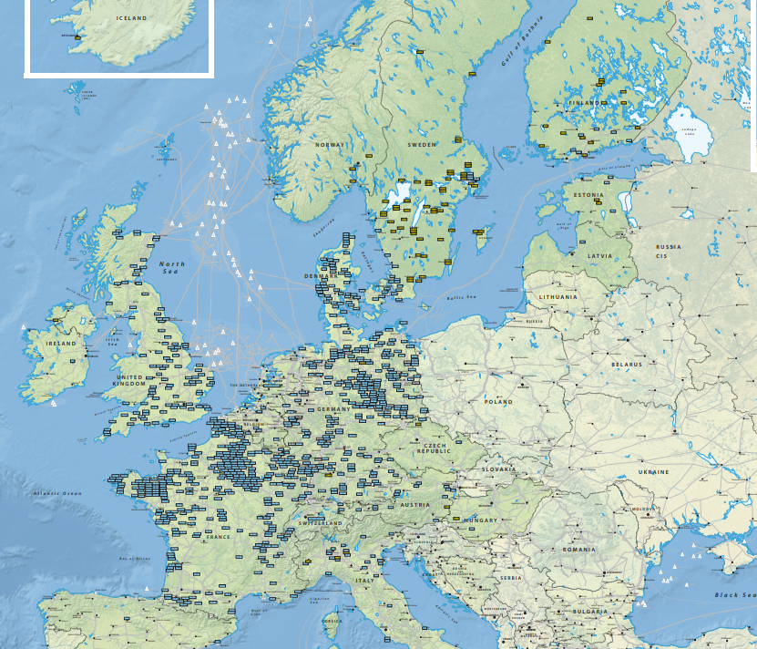
1,200 biomethane plants in Europe today.

Slide 7
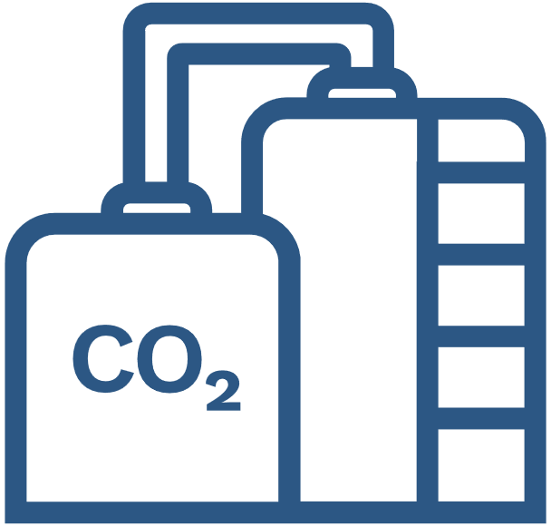
What we do
Sourcing CO2
Transport and storage
Credit generation and sales

Slide 8
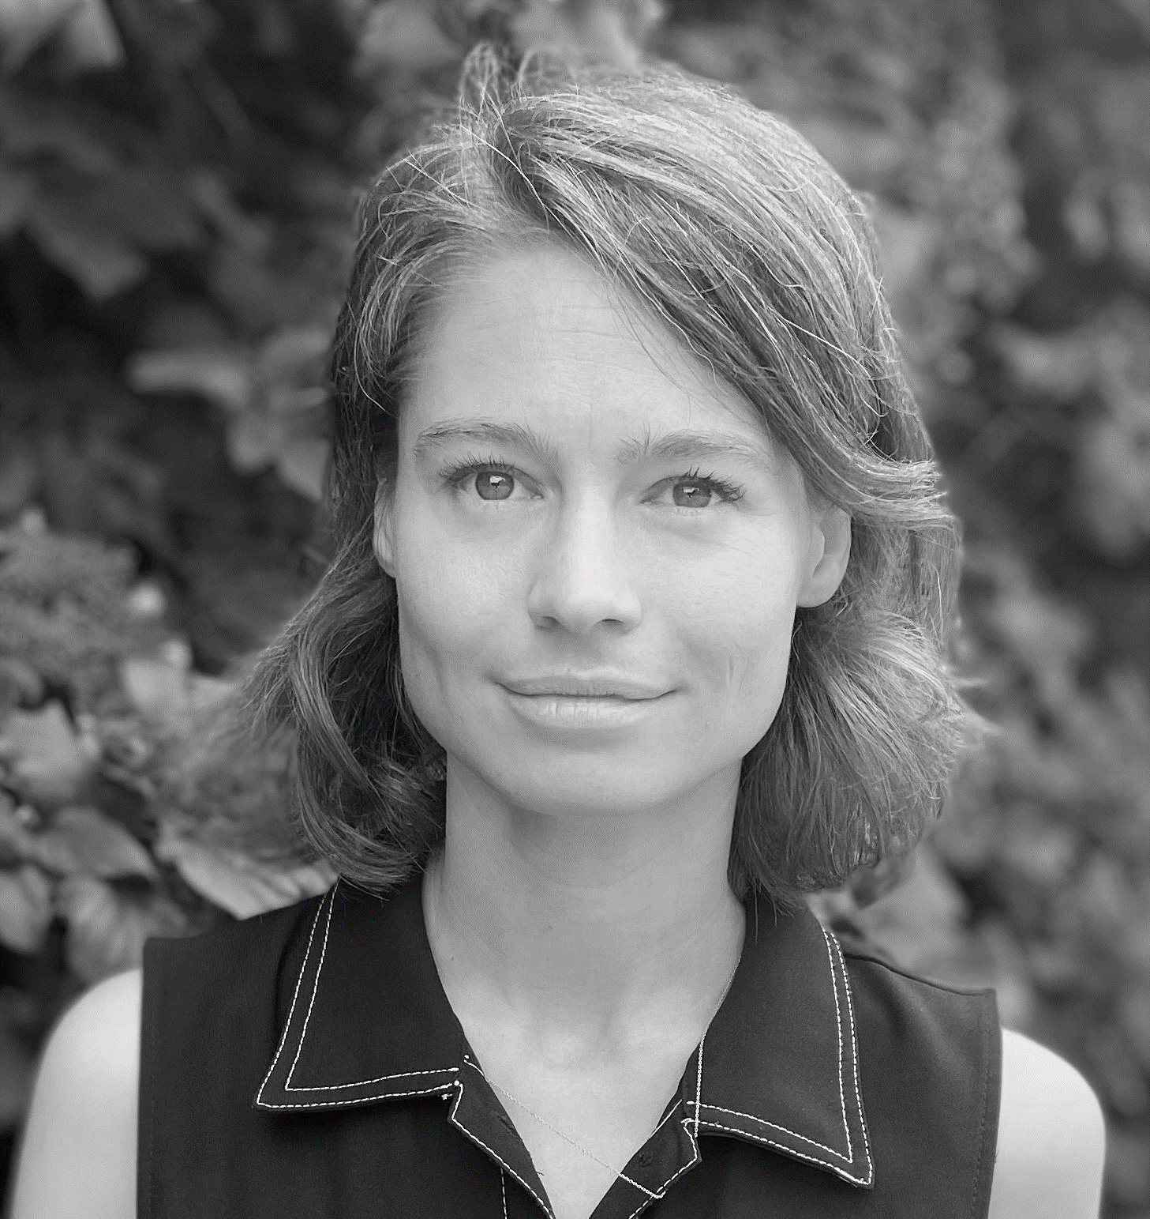
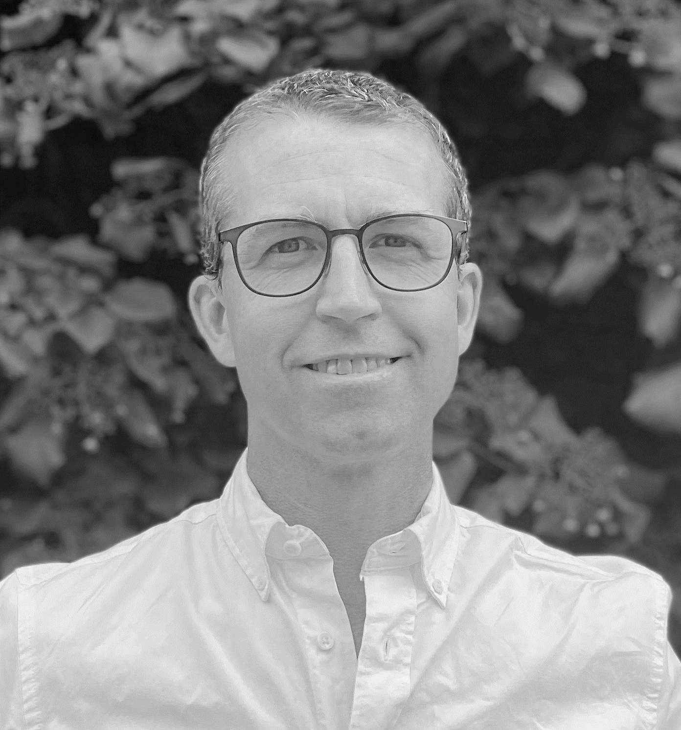
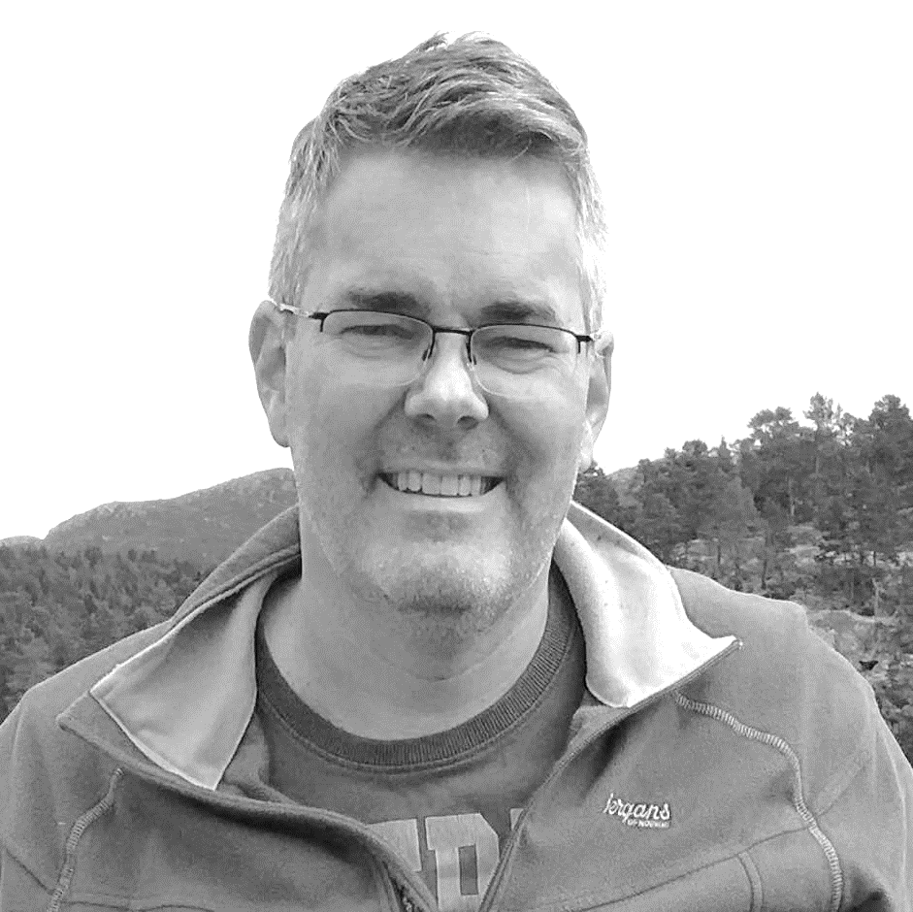
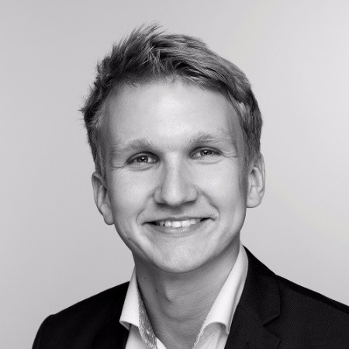
The team has deep industry experience combined with execution power and strong investors
Mike Carpenter
Co-Founder & CEO
Kaja Voss
Co-Founder & COO
Audun Røsjorde
CTO
Erling Brækhus Haugsand
CCO
With experience from
Investors

Slide 9
