Slide 1
Enabling a sustainable energy transition

Slide 2
DECARBONIZATION & ELECTRIFICATION DRIVES THE NEED FOR ENERGY STORAGE
WE WILL REQUIRE MORE THAN 100 TWH OF GRID SUPPORTING ENERGY STORAGE BY 2040…
..WITH A GLOBAL MARKET POTENTIAL OF 4 TRILLION USD *
DRIVERS
CONSTRAINTS
ENABLER
DECARBONISATION
ELECTRIFICATION
MORE RENEWABLES
“NET ZERO”
LIMITED
GRID CAPACITY
MORE ENERGY STORAGE
* McKinsey / LDES Council

Slide 3
GRID-SUPPORTING ENERGY STORAGE TECHNOLOGIES
PUMPED STORAGE (ABOVE GROUND)
RESPONSE: MINUTES
USED FOR: SEASONAL ENERGY STORAGE, BALANCING SERVICES, GRID INERTIA
LIFESPAN: 60+ YEARS
MINE STORAGE
RESPONSE: SECONDS
USED FOR: DAILY ENERGY STORAGE, BALANCING SERVICES, GRID INERTIA
LIFESPAN: 60+ YEARS
Discharge Time at Rated Power
LITHIUM-ION BATTERIES
RESPONSE: MILLISECOND
USED FOR: BALANCING SERVICES
LIFESPAN: 9-11 YEARS
HYDROGEN & FUEL CELLS
RESPONSE: SECONDS-MINUTES
USED FOR: OFF GRID ENERGY MOBILITY, INDUSTRIAL APPLICATIONS
LIFESPAN: NOT YET PROVEN
Energy

Slide 4
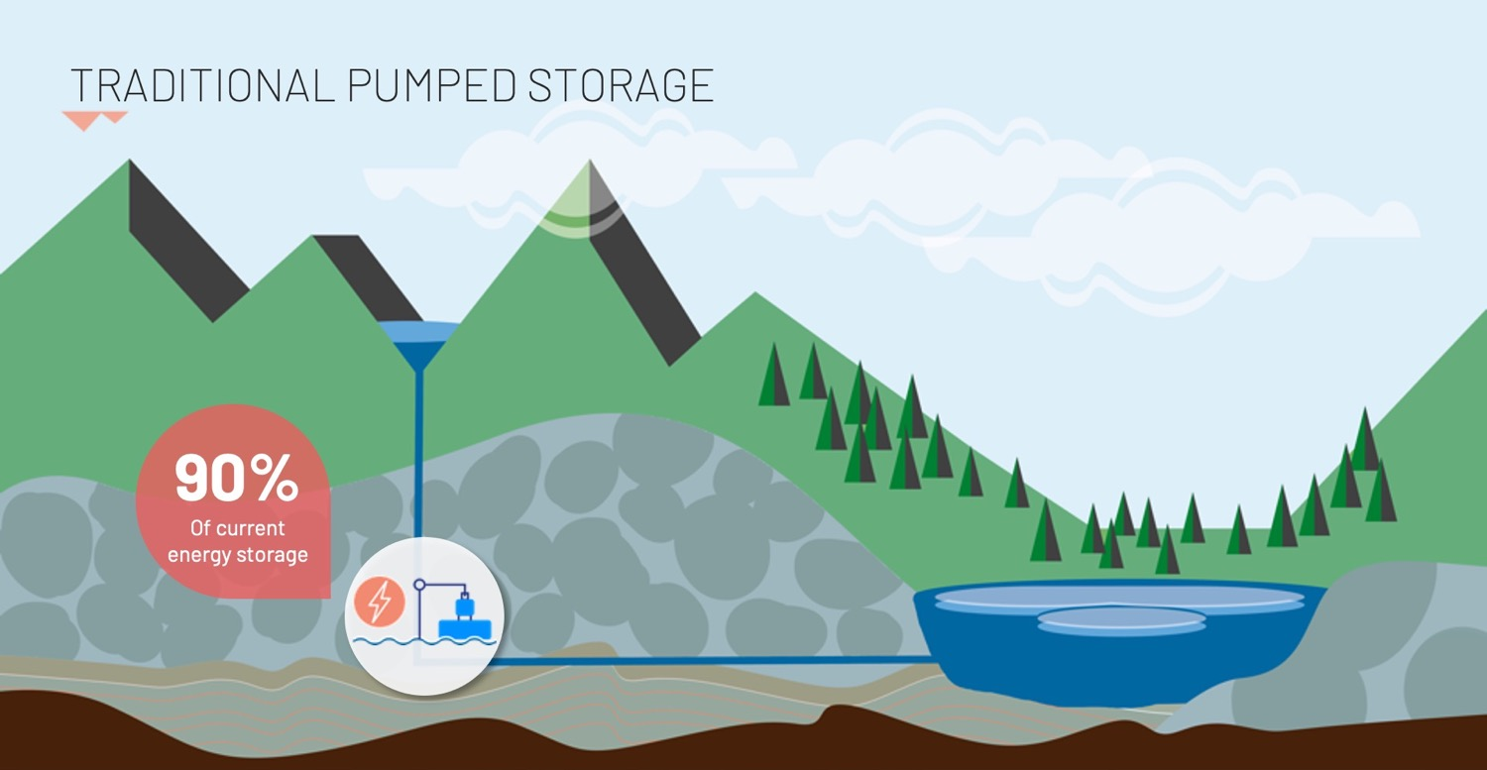

Slide 5
MINE STORAGE CONCEPT
Same proven technology as pumped storage
Grid-scale application
Long lifecycle of +60 years
Low levelized cost of storage (LCOS)
Low environmental and local impact
Pumping
Generation
We use the
cleanest media..
WATER
..and the most reliable force
GRAVITY
Powerhouse

Slide 6
GLOBAL POTENTIAL WITH 1 MILLION MINES IN THE WORLD
The Nordics
9 495*
USA
173 350*
UK & Ireland
23 806*
Germany
7 833*
Spain
5 175*
South Africa
1 410*
Australia
16 587*
Chile
1 411*
* Registered closed mines, Mindat.org

Slide 7
THE MINE STORAGE WoWTM OUR WAY OF WORKING
Secures profitable business cases that attract investors
Industrialises quality & efficiency
Builds company value beyond the SPVs
Enables
faster scale-up
QUALIFICATION
DEVELOPMENT
CONSTRUCTION
OPERATION

Slide 8
BUSINESS MODEL
REVENUES FOR A MINE STORAGE
ELECTRICITY
TRADING
ANCILLARY
SERVICES
GRID
STABILITY
RENEWABLES INTEGRATION
END USER INDUSTRIAL
Utilizing price variations
Frequency regulation
Network stability
Capacity reserve & transmission support
Production optimization of wind and solar
Energy cost management Power supply reliability

Slide 9
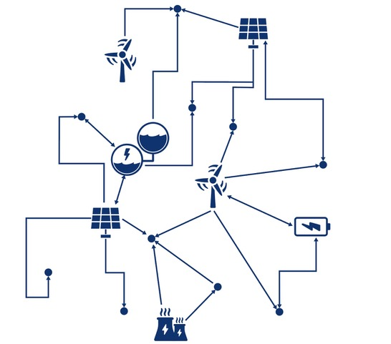
WE’RE CREATING A RENEWABLE VIRTUAL POWER PLANT
enables energy asset owners and industries
to collaboratively operate their assets
through 24/7 automation
based on algorithms, machine learning, and artificial intelligence

Slide 10
BUILDING MINE STORAGE TO BECOME A GLOBAL LEADER
15 people whose combined experience includes:
200 years within many areas of the power industry
Completing 30+ infrastructure projects
19 start-ups
50+ years building and operating energy SaaS services
Deep knowledge of Machine Learning and Artificial intelligence
Thomas Johansson
Co-founder & CEO
Raine Vasanoja
Co-founder & CCO
Anna Engman
Co-founder & CMO
Mikael Larsson
CFO & Energy Markets
Stefan Borsos
H.o. Business Development
Håkan Martinsson
H.o. Project Development
Robert Magnusson
H.o. Development
of Asset Management
Maria Säfström
H.o. Environment
& Permitting
Stefan Sädbom
Chief Geologist
Francisco Pinto
Ass. Project Manager
Niclas Ehn
Co-founder CEO Expektra
Gustav Bergman
Co-founder CTO Expektra
Andreas Johansson
Developer Expektra
Mattias Johnsson
Data Scientist Expektra
Morgan Svensson
R&D Engineer Expektra

Slide 11
PROJECT PIPELINE
PROJECTS
10 Projects in Nordics, land rights negotiations closed/on-going
Pre-EIA activities on several sites
>1 GWh in pipeline
Vånga 1st Project in Development phase
PROJECT PARTNERS
Mälarenergi
Dairyland Power Cooperation
International renewables developer
Negotiations with:
German automotive giant
Energy company in South Europe

Slide 12
MINE STORAGE PIPELINE REALIZATION
14
800 MW
11
KEY FINANCIAL ASSUMPTIONS:
DEVEX: 1,5 - 2 MEUR per SPV
CAPEX: 1,2 – 1,8 MEUR / MW
OPEX: 2-4% of CAPEX p.a.
TECHNICAL LIFE: 60+ years
600 MW
8
6
400 MW
4
3
200 MW
2
2027
2028
2029
2030
2031
2032
2033
Number of projects in operation
Acc MW in operation

Slide 13
THANK YOU!

